Slide 1
Conundrum of Chemical Thromboprophylaxis in Surgery And Trauma
Dr Gordon Ogweno
Consultant Anaesthesiologist
Lecturer in Medical Physiology
Kenyatta University
Presentation Made during KSA 21st Congress in Merica Hotel,
Nakuru, Kenya

Slide 2
Why worry about VTE?
Thromboembolism and sequelae leading cause of preventable death/morbidity in trauma```````?surgery````
Diagnosis and treatment are still a conundrum
Progress made in risk factor identification and prophylaxis largely contributed by anaesthesiologist

Slide 3
Conundrum in Diagnosis of VTE
Postulated to result from gelation of coagulation factors on endothelium—detachment and progression?
Analysis of circulating factors not diagnostic-useful in following treatment
Gold standard dx are radiological-evidence of vascular occlusion/non compressibility
Venography/ultrasonography; spiral CT scan

Slide 4
VTE in Trauma:seminal study
Prospective follow up of trauma pts-716 enrolled, no prophilaxis
Contrast venography and impedance plethysmography done
Findings:
Venography DVT=201/349(58%)
Face,chest abdomen=65/129(50%)
Major trauma=49/91(54%)
Spinal=41/66(62%)
Lower extremity/ortopaedic=126/182(69%)
Pelvic=61/100(61%)
Femoral=59/74(80%)
Tibial=66/86(77%)
William,NEJM,1994;331(24):1601-6

Slide 5
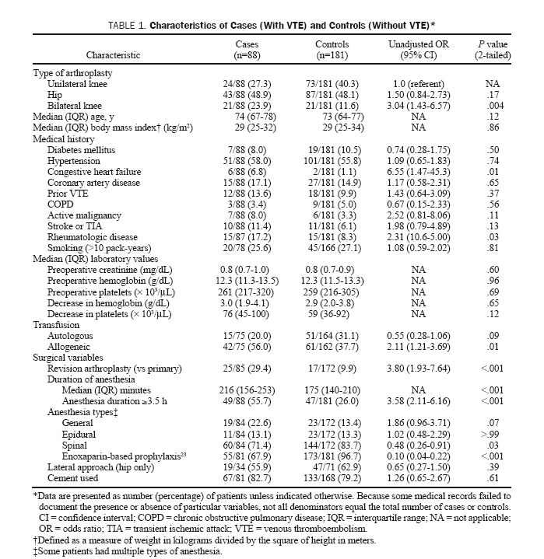
Risk factors for VTE in Surgery
Mayo Clin Proc,2005;80(6):732-738

Slide 6
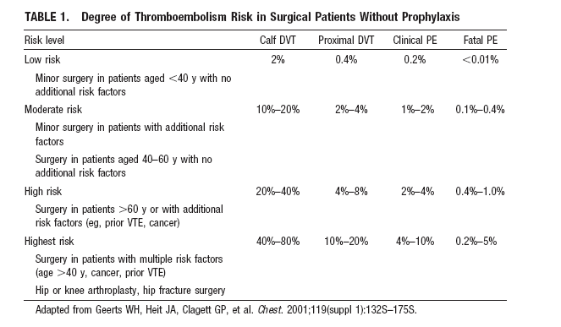

Slide 7
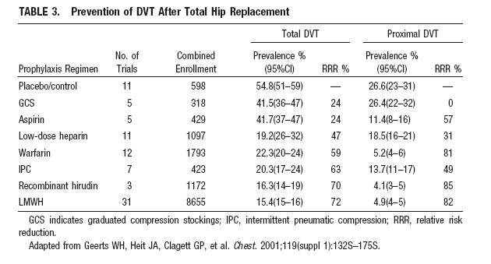

Slide 8
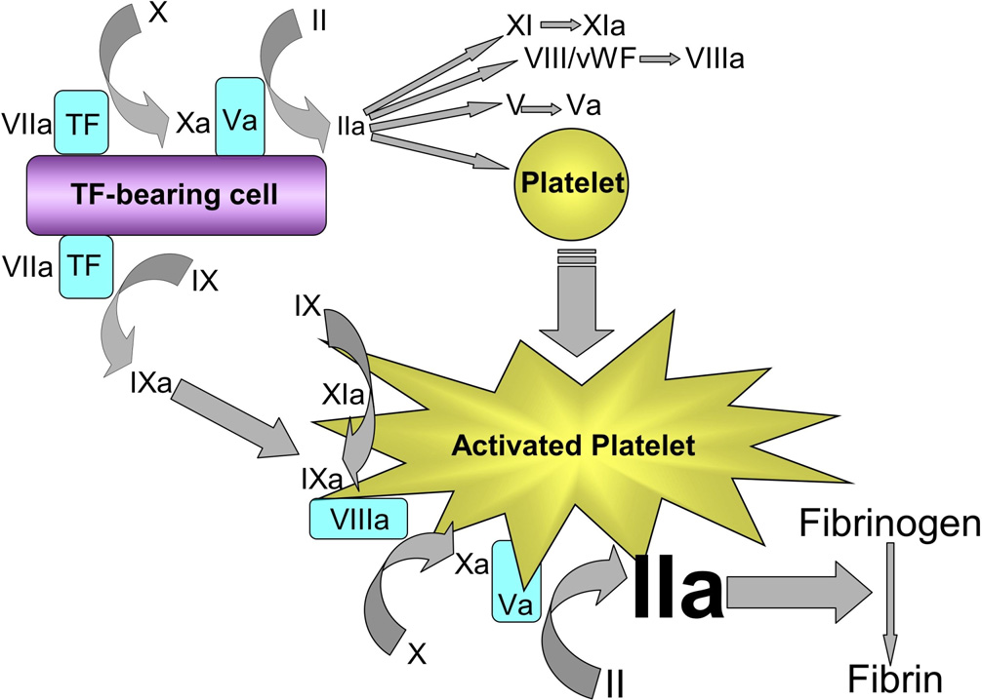
Cell based model of Thrombin generation

Slide 9
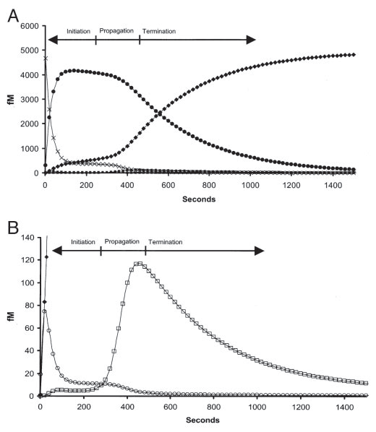
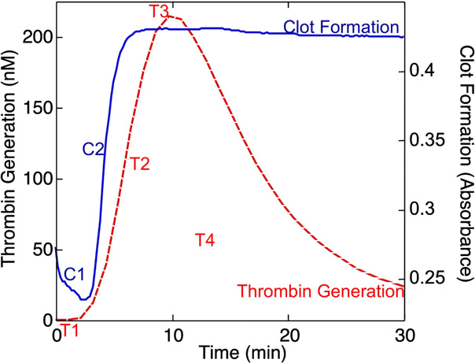
Thrombin generation beyond gel point

Slide 10
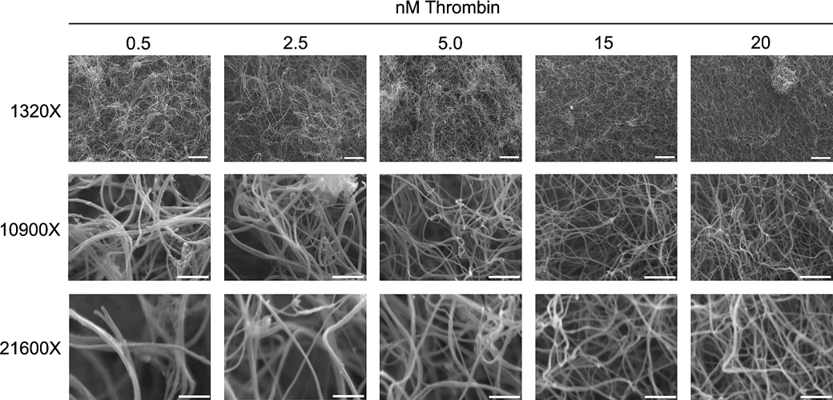
SEM of Structure of fibrin clots and thrombin concentration
Wolberg, Blood Reviews, 2005;21:131-142

Slide 11
My Data

Slide 12
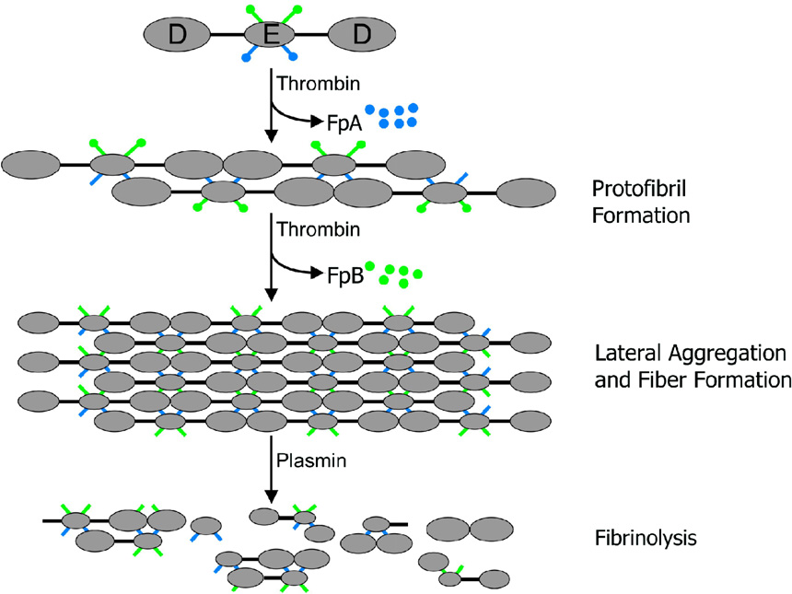
Fibrin formation and dissolution
Wolberg, Blood Reviews, 2005;21:131-142

Slide 13
Timelines in development of anticoagulants
1909
1939
1941
Hirudin-parenteral
Heparin-parenteral uhmwh
1985
1990
Enoxaparin-parenteral LMWH
Argatroban-parenteral DTI
2000
2001
2008
2012
Bivarudin
Fondaparinux
Dicouamarin-oral vka
Dabigatran&Rivaroxaban
Apixaban

Slide 14
Antithrombotics That Have Changed Clinical Practice
Anticoagulants
Low-molecular-weight heparin
Antiplatelet Drugs
Thienopyridines
Glycoprotein IIb/IIIa Inhibitors

Slide 15
Limitations of Heparin Therapy
Variable anticoagulant response-AT dependence
Dose-dependent clearance-saturation of reservoirs
Reduced activity in presence of platelets:PAF
Unable to inactivate fibrin-bound thrombin-exosite-2
Unable to inactivate factor Xa within the prothrombinase complex
Development of HIT
Short half life-needs continous Infusion

Slide 16
Enoxaparin-standard of care
Decrease in MW, predictable effect, longer duration
Less need for dose monitoring
Balanced efficacy vis untoward effect
Less HIT
Outpatient management

Slide 17
Clinical trials comparing anticoagulants
Trial | anticoagulant | comparator
Remodel,emobilize, Renovate | dabigatran | enoxaparin
Apropos, Advance 1,2,3 | Apixaban | Enoxaparin
Record 1, Record 2, Record 3 | Rivaroxaban | Enoxaparin
Ephesus, Pentathlon, Penthifra | fondaparinux | Enoxaparin

Slide 18
Dabigatran for prevention of VTE after major orthopaedic surgery: results
 | Enoxaparin | Dabigatran (150 mg) | Dabigatran (220 mg)
DVT, PE and all-cause mortality (%)
RE-NOVATE | 6.7 | 8.6 p<0.0001* | 6.0 p<0.0001*
RE-MOBILIZE | 25.3 | 33.7 p=0.0009† | 31.1 p=0.02†
RE-MODEL | 37.7 | 40.5 p=0.0005* | 36.4 p=0.0345*
Major bleeding (%)
RE-NOVATE | 1.6 | 1.3 | 2.0
RE-MOBILIZE | 1.4 | 0.6 | 0.6
RE-MODEL | 1.3 | 1.3 | 1.5
*Non-inferior to enoxaparin; †inferior to enoxaparin Eriksson et al. Blood 2006; Friedman et al. J Thromb Haemost 2007; Eriksson et al. J Thromb Haemost 2007

Slide 19
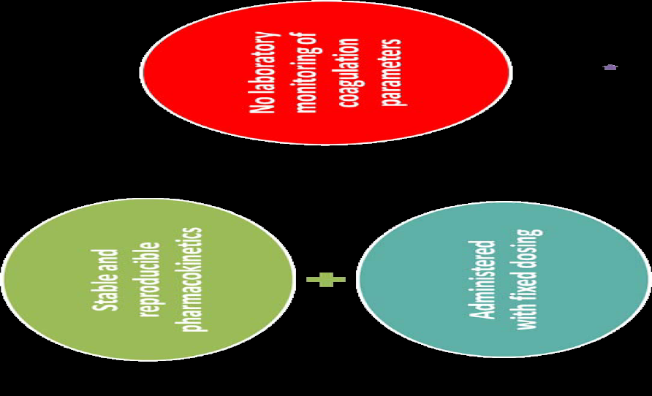
No Need to Monitor LMWH/New anticoagulants

Slide 20
Cochrane review issue 3, 2013
Systematic review of RCT thromboprophylaxis-mechanical or chemical
Endpoint on mortality or incidence of DVT or PE in trauma patients
Conclusion:
No evidence of reduction of mortality or PE
Found evidence of some protection against DVT
Although evidence not high, recommend prophylaxis in severe trauma and surgery

Slide 21
Unresolved issues in Chemical prophylaxis
Optimal thromboprophylaxis in patients on long term anticoagulation scheduled for surgery
Benefit of anticoagulation in laparoscopic surgery and arthroscopic procedures
Clinical value of routine screening for VTE after high risk surgery
Optimal time to start and duration of chemical prophylaxis for VTE in surgical patients

Slide 22
Why Do Chemical thromboProphylaxis fail?
Reduction of AT with haemodilution
Na+ load-procoagulant
Stimulation of natural anticoagulants and fibrinolysis due to hypoperfusion
Limitations of stochiometric inhibition-overwhelming thrombin tissue release
Failure of Fibrinolytic system
ANTICOAGULANTS ≠ ANTITHROMBOTICS

Slide 23
Topical Issues in VTE
Despite progress, VTE still common
Limitations of existing treatments
Timing of thromboprophylaxis in patients undergoing surgery
Need for extended prophylaxis
Underuse of thromboprophylaxis
Limitations of existing data: (a) differing definitions of VTE and bleeding; (b) missing venography data in clinical trials
Limitations of existing guidelines: (a) AAOS vs ACCP in orthopaedic surgery; (b) children
Drugs suppl, 2010;70(suppl 2):11-18

Slide 24
Take Home!
Surgery and trauma are hypercoagulable unless dysregulated
Bleeding complications are organ specific
Patients undergoing anaesthesia under increased risk of VTE
Chemical thromboprophylaxis has a role
Apply clinical judgment
Enoxaparin still remains gold standard comparator

Slide 25
Lets talk sense-conundrum
Puzzle
Mystery
Challenge
Poser
Problem
Riddle
Enigma
dilemma
Bewilder
Baffle
Confuse
Bamboozle
Mystify

