Slide 1
Neuro critical Care: Focus on Cerebral Oedema
Dr Gordon Ogweno
Consultant Anaesthesiologist/Neurocritical Care
Lecturer in Medical Physiology
Kenyatta University

Slide 2

Neuro Critical Care
Life-threatening neurologic illness may be caused by primary or secondary disorders affecting the nervous system
Focuses on:
Preservation of neurologic tissue
Prevention of secondary brain injury as a result of cerebral ischemia, cerebral edema, and increased ICP

Slide 3

Treatable Secondary brain insults: Edema and ICP
Prevention of secondary brain injury due to:
cerebral ischemia
cerebral edema
increased ICP
Elevations in intracranial pressure may induce irreversible brain damage or death by two mechanisms:
Mechanical distortion (brain shift) and compression (herniation) of brain tissue as a result of intracranial mass effect and compartmentalization
Global ischemic injury as a consequence of decreased cerebral perfusion pressure and cerebral blood flow

Slide 4
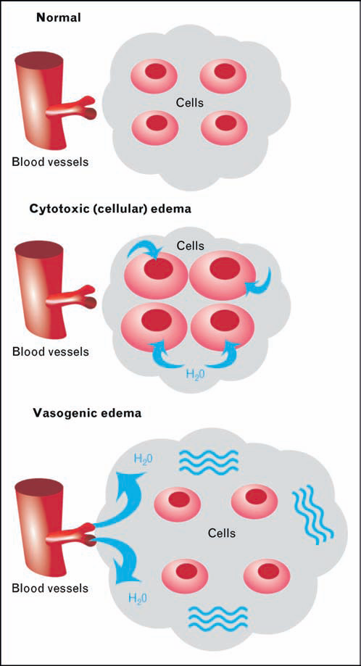
Schematic demonstrating cytotoxic and vasogenic
cerebral edema

Slide 5
Vasogenic Brain Edema
typically seen in the vicinity of tumor growths, infections (eg. abscesses) and traumatic brain injury
caused by damage to the blood brain barrier causing increased permeability of the capillary endothelial cells and leakage of proteins into the brain parenchyma
the proteins create a gradient drawing the water out of the blood vessels into the brain cells, affecting the white matter more than the gray matter
Treatment: Glucocorticosteroids

Slide 6
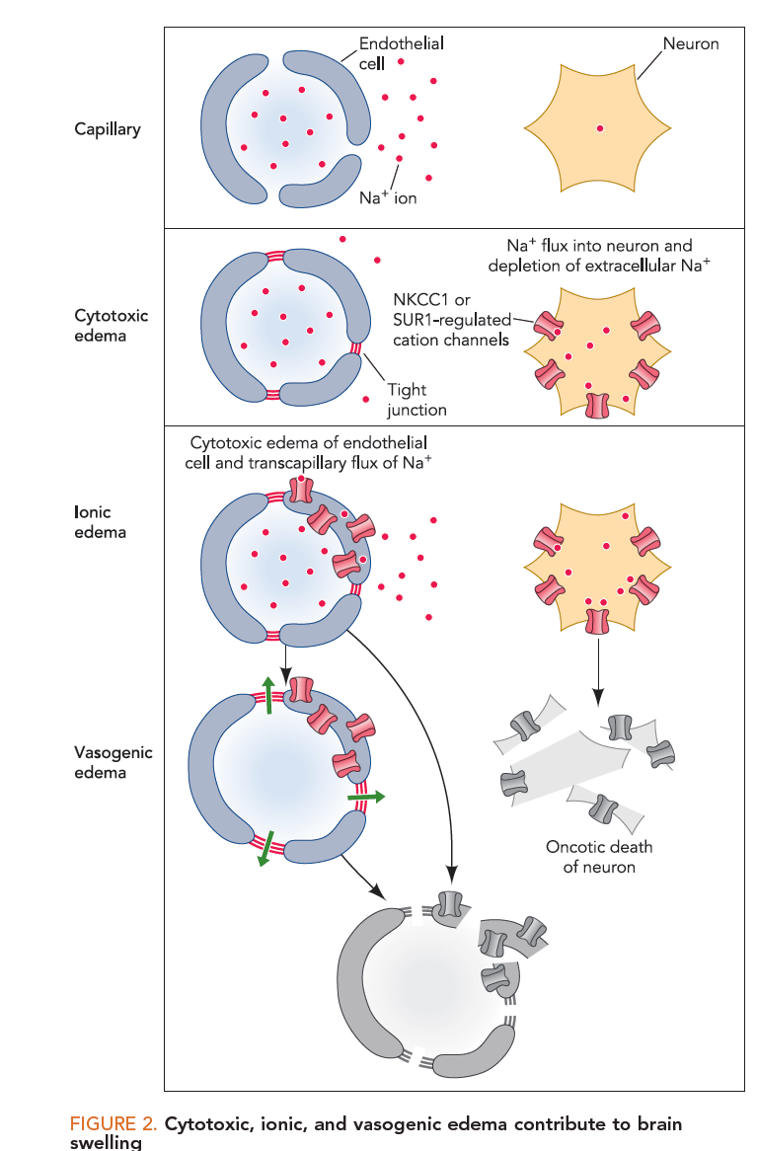

Slide 7
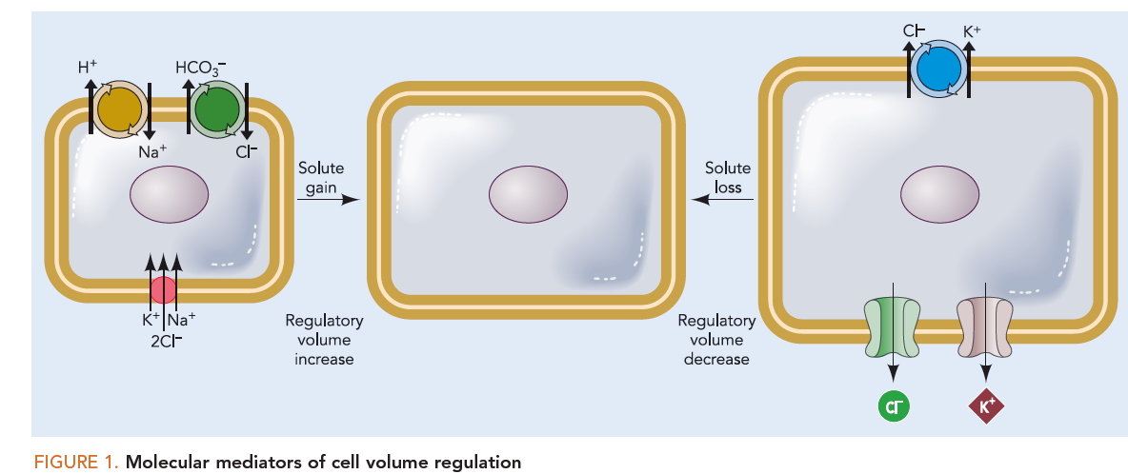

Slide 8
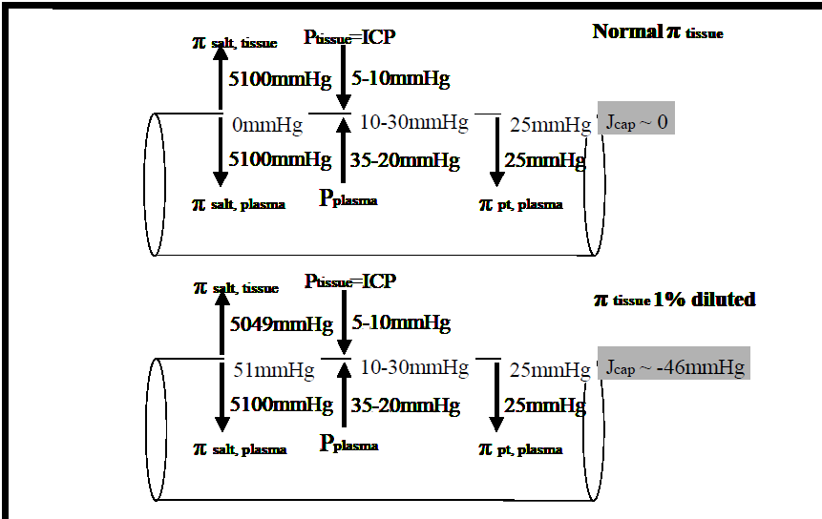
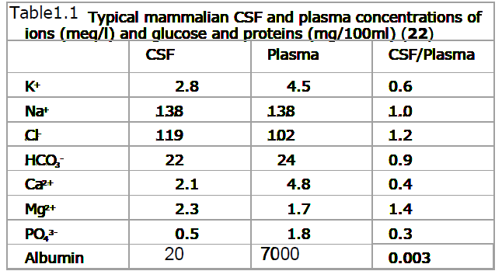
HyperOsmotic agents: Not the Whole picture?

Slide 9
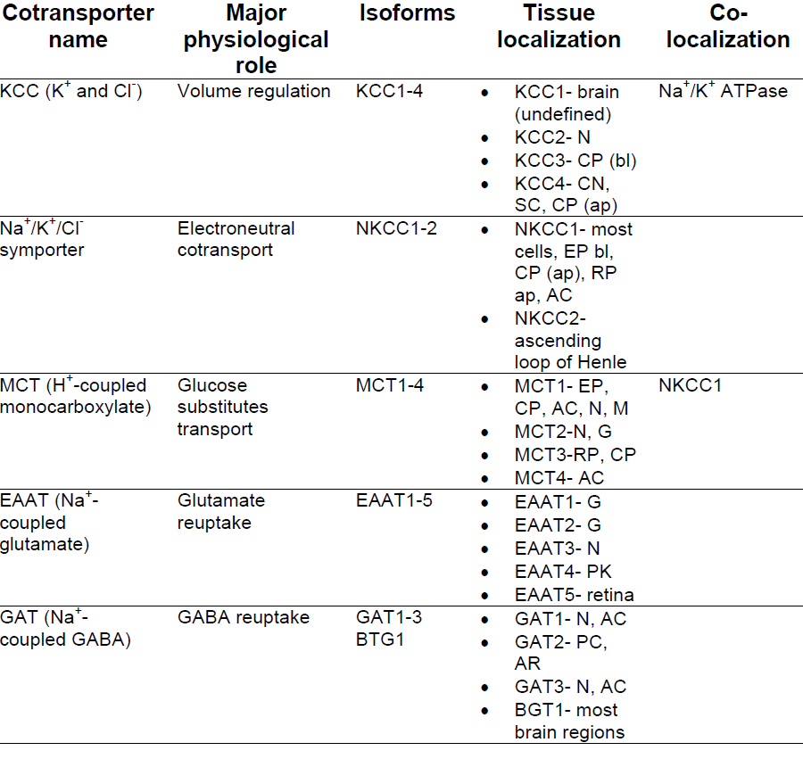
Membrane transporters: Relation to NT

Slide 10
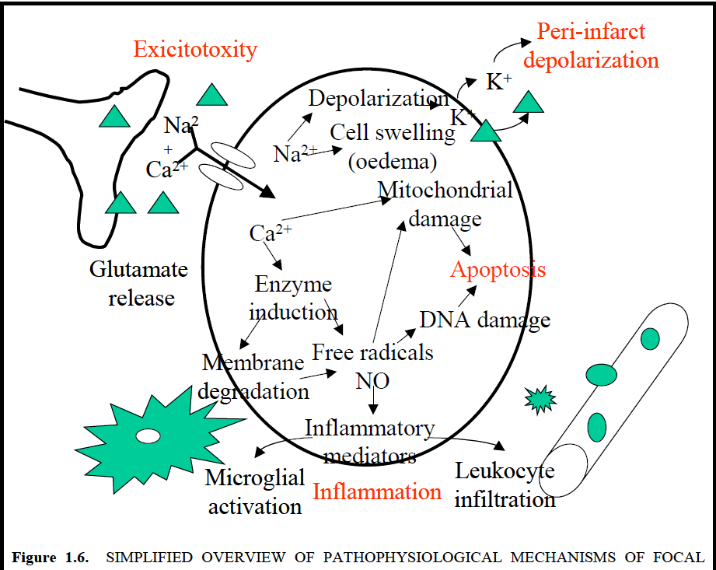

Slide 11
Interstitial Brain Edema
also known as hydrocephalic edema
seen in patients with high pressure obstructive hydrocephalus (increase CSF pressure within the ventricles)
CSF seeps through the ependymal cells into the periventricular extravascular intracellular compartment of the brain
Treatment: Shunting
Ventriculostomy (temporary)
Ventriculoperitoneal shunt (permanent)

Slide 12
Cerebral Edema
The bulk of the brain can also be increased by the development of cerebral edema.
Types of edema:
Cellular (Cytotoxic) edema
Vasogenic edema
Interstitial edema

Slide 13
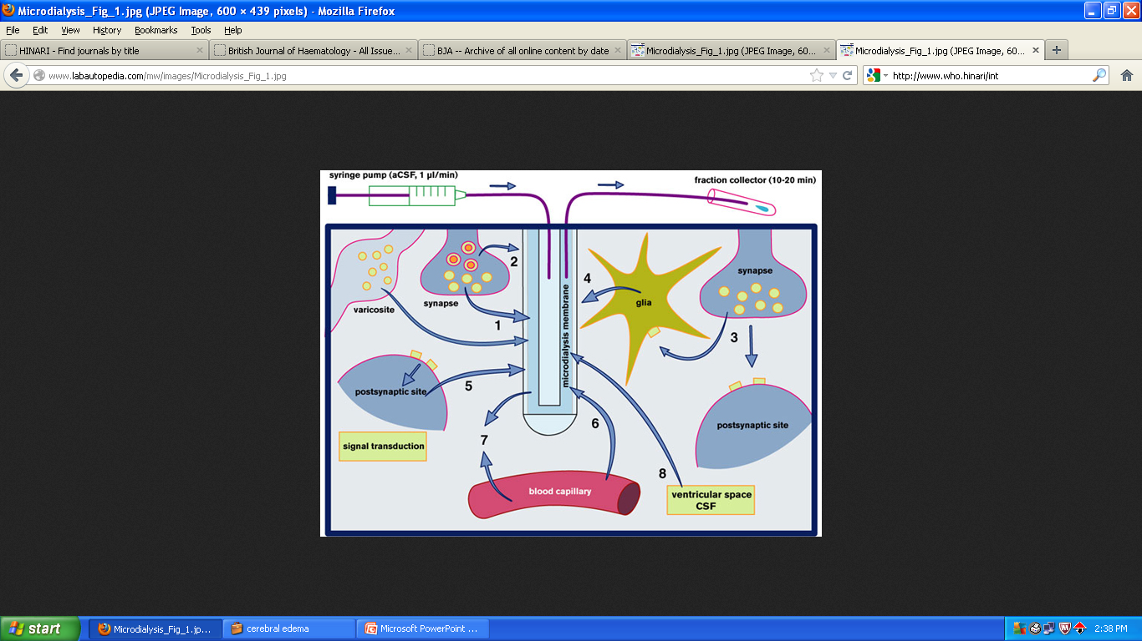

Slide 14
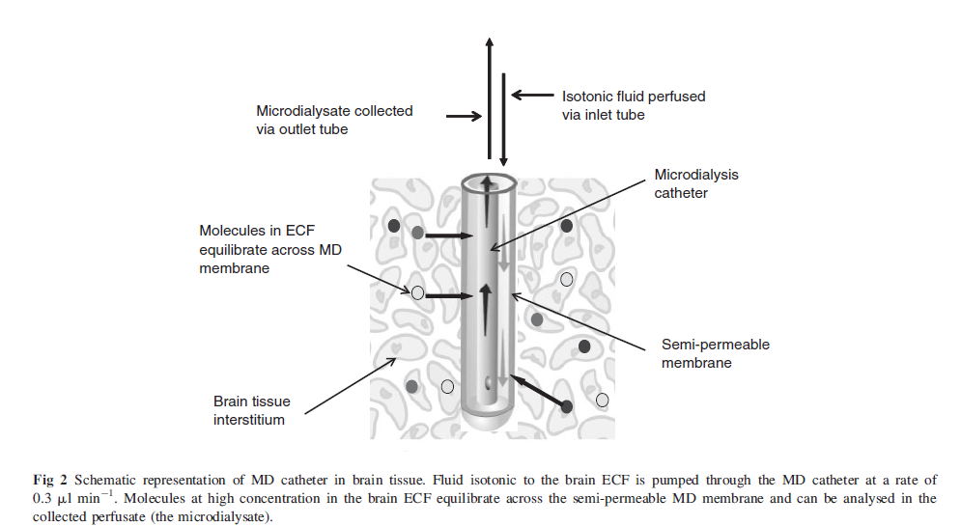

Slide 15
