Slide 1
Colloids In Anaesthetic Practice
G Ogweno
Dept of Medical Physiology
Kenyatta University

Slide 2
Why Colloids over crystalloids?
Crystalloids :
Extravasate=only 25% remains in circulation after 20 mins
used for extravascular fluid replacement
short term effect on plasma=transient
Large volumes=pulmonary oedema, ARDS, hyperchloremic metabolic acidosis, dilutional coagulopathy
Colloids:
Suspension of colloids in crystalloid carrier solution
Don’t traverse endothelial barrier
Remain in circulation longer
Added water retention=plasma volume expansion
Small volumes, longer effects=intravascular replacement

Slide 3
Plasma Volume therapy
Colloids
Blood+/components
Natural:
Albumin
Artificial:
gelatin
Dextran
Starch
Whole blood
Packed red cells
FFP
Plasma Proteins(bioplasma)

Slide 4
Choice of Volume therapy
Whichever one chooses:
1.Choose the fluid for the correct purpose.
2.Know the composition of the fluid chosen.
3.Be aware of the risks and benefits of the particular fluid chosen

Slide 5
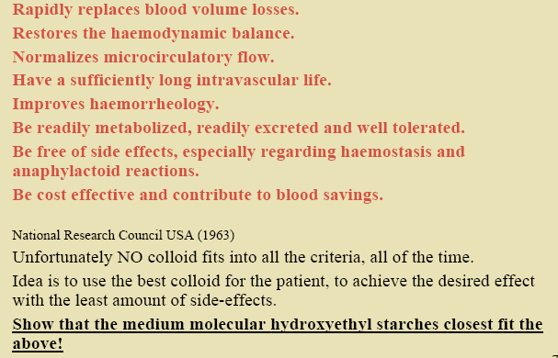
What is the Ideal Colloid?

Slide 6
Properties of the “ideal plasma substitute
Distributed in intravascular compartiment only
Readily available
Long shelf half-life
Inexpensive
No special storage or infusion requirements
No special limitations on volume that can be infused
No interference with blood grouping or cross-matching
Acceptable to all patients & no religious objections to its use.
Iso-oncotic with plasma
Isotonic
Low viscosity
Contamination easily detected
Half-life should be 6-12 hours
Should be metabolised or excreted, not stored in body

Slide 7
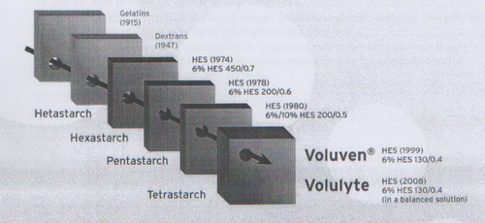
Historical Evolution of Artificial Colloids

Slide 8
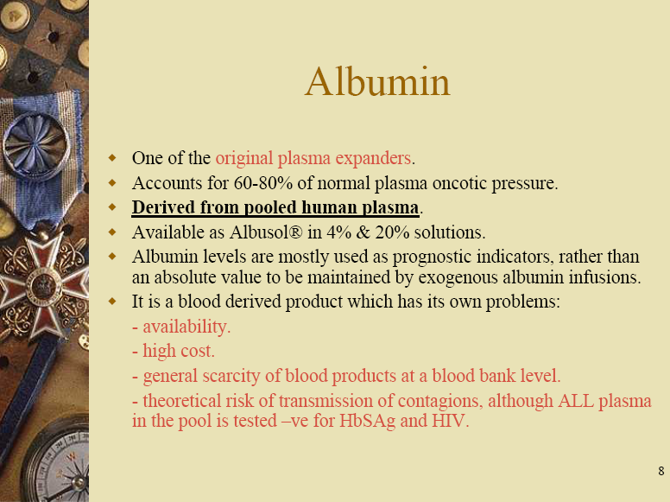

Slide 9
Gelatins
Advantages
Disadvantages
Small MW=rapid excretion
Preservative free
Only 1% metabolized
No storage in RES
Minimal effect on coagulation
Bovine source(collagen)=disease transmission
Rapid clearance= continuous infusion, more volume
Anaphylactoid reactions

Slide 10
Dextrans
Advantages
Disadvantages
Decreased:
blood viscosity,
platelet adhesiveness,
RBC aggregation
Clinical uses:
plastic surgery,
carotid end arterectomy
prophylaxis of thrombembolectic phenomenon
Briefer volume expansion
Highest incidence of anaphylactic reactions
Interferes with blood grouping , clotting, antiplatelet
Worsen renal failure
Hyperviscosity syndrome in renal tubules

Slide 11
Hydroxyethyl Starches (HES)
Introduced in 1960s to overcome drawbacks of Dextrans, albumin and gelatins
Derived from natural plant starches-waxy maize or potato
Modified amylopectin
Progressive reduction of MW and molar substitution over years

Slide 12
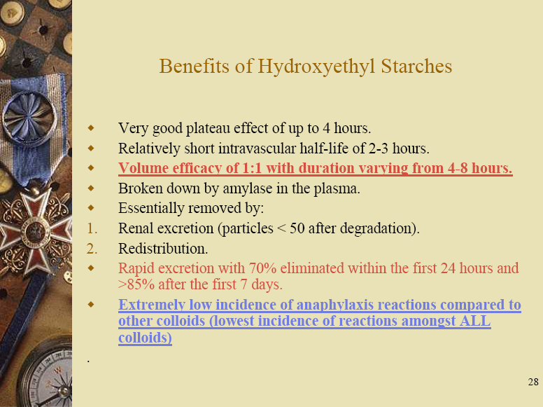

Slide 13
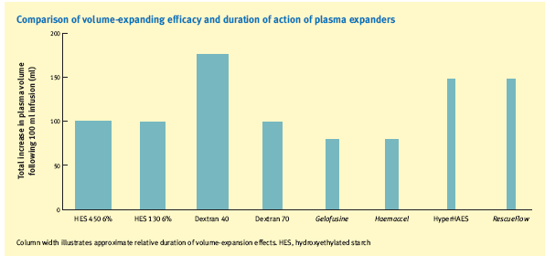
Volume expanding efficacy of Colloids

Slide 14
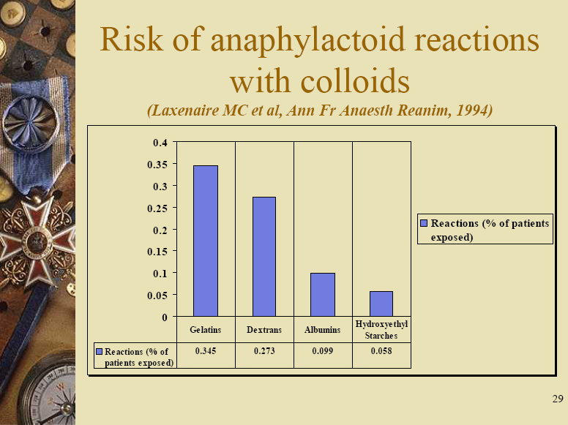

Slide 15
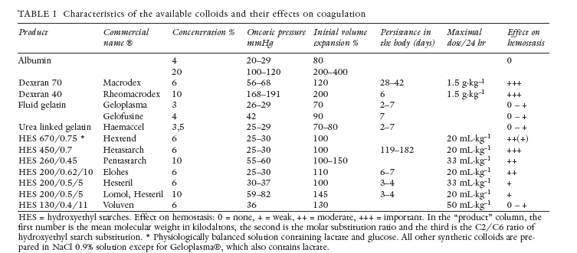
Effects of colloids on Haemostasis
Van Linden et al 2006

Slide 16
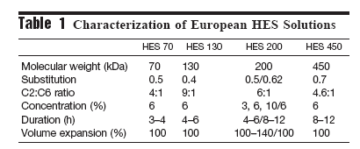

Slide 17
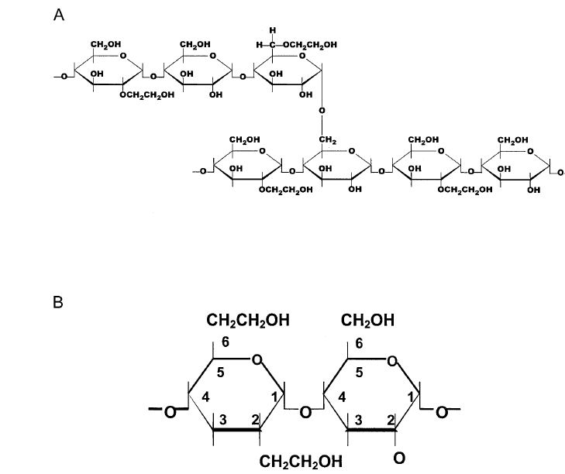
Hydroxyethyl Substitution

Slide 18
Language of HES
%concentration=g/dL e.g isooncotic 6% vs hyperoncotic 10%
MW e.g Low( 130 kDa) high (670 kDa)=renal clearance and effect on coagulation
Degree/molar substitution –number of glucose molecules with hydroxyethyl e.g low (0.4) vs high(0.7)=volume expanding (efficacy)effects and safety profile
C2/C6 pattern of substitution=resistance to amylase degradation and impairment of haemostasis e.g 9:1 vs 7:1

Slide 19
Achievement of Desirable HES features
Reduction in side effects:lower MW and lower degree of substitution e.g 130/0.4 (Voluven/volulyte)
Good duration of effects: high pattern of C2/C6 substitution ratio
Currently available products: 6%/130/0.4/9:1=Voluven (in Normal saline) or volulyte (in balanced salt solution)

Slide 20
Benefits of LMW, ms, high C2/C6 HES
No volume limits=upto 70ml/d
No contraindication in children, sepsis, neuroaxial blockade and neurosurgery
Minimal effects on haemostasis
Minimal cumulative renal effects

Slide 21
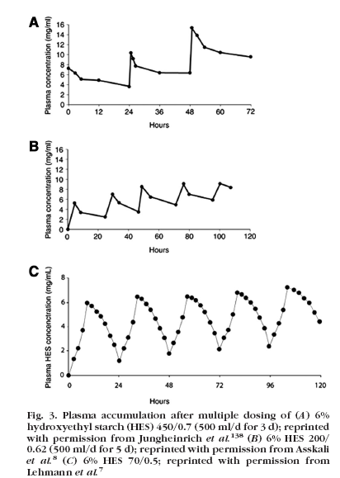
Cumulative effects of HES

Slide 22
Potential limitations of HES
Pruritus-if used long term, not acute
Errors in serum amylase assay levels
Coagulopathic bleeding-problem of older HMW, highly substituted

Slide 23
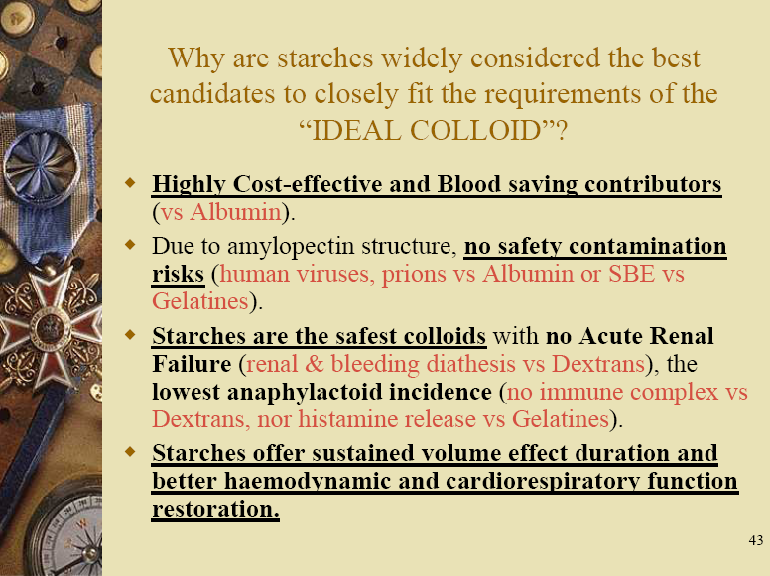

Slide 24
Current practice trends
Concern regarding effects of colloids in relation to anaphylaxis, coagulopathy, renal dysfunctions and metabolic changes
Banning of gelatin use in US
Phasing out of Dextrans-withdrawn from use
Popularity of HES
Preponderance of lower MW HES
Waxy maize derivatives offer more benefits and safety compared to potato starch derivatives
Voluven/vululyte in the EU community

Slide 25
Conclusion
Current evidence supports efficacy and safety of HES
Lets adopt evidence based practice like the rest of the world in using colloids
Are we ready to phase out gelatins and dextrans from our operating theatres?

