Slide 1
Herbal medicines and blood clotting in the Perioperative settings
Dr Gordon Ogweno
Department of Medical Physiology
Kenyatta University

Slide 2
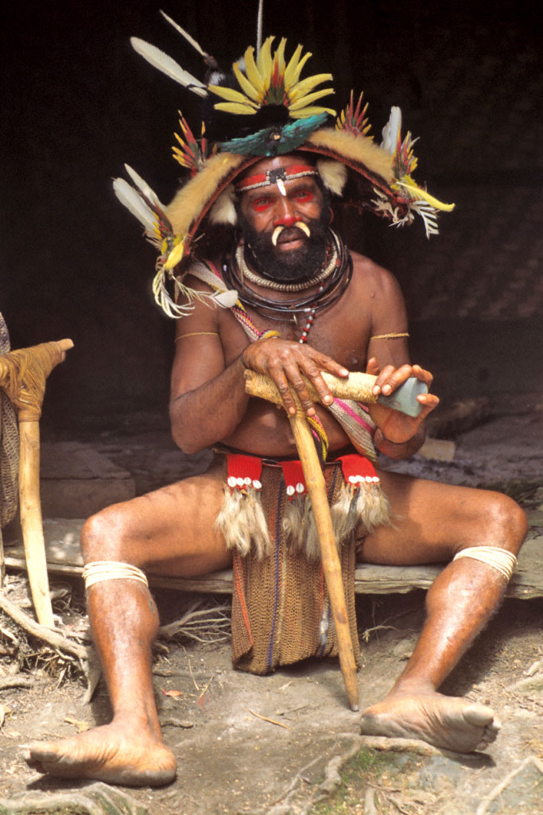
Portrait of herbal practitioner?

Slide 3
Background
WHO estimates that about 80% of world population relies on herbal/alternative medications=30% plant species used
Reasons include: direct consumer marketing, inclusion in multivitamin preparations in prevention of chronic illnesses
Toxicities of concern=thrombohaemorhagic complications most severe
Due to prevalent use of anticoagulants and antiplatelets=interactions in perioperative settings resulting in haemorhage most dangerous

Slide 4
The problem
There is widespread use of herbal/complimentary/alternative medications among presurgical patients
These medications can potentially interact with haemostatic system
consequential bleeding or thrombosis continue being reported
effects not fully characterised
Agents exempted from formal licensing
information of effects not fully available to anaesthetists
patients may suffer due to our ignorance

Slide 5

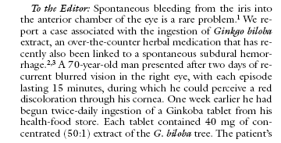
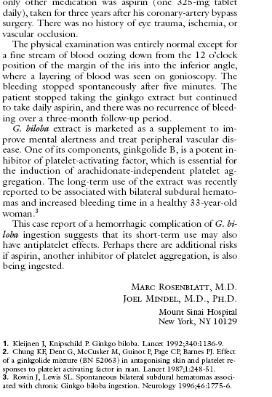
New England Journal of Medicine April 10, 1997 ; 336(15):1108

Slide 6
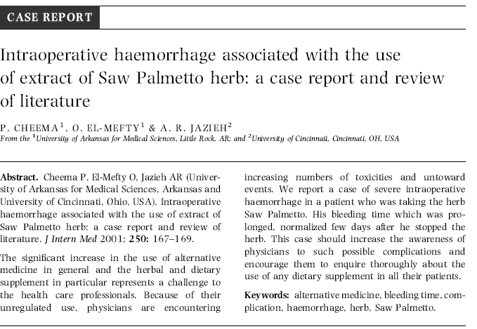

Slide 7
Documented claims
Retard blood clotting
procoagulant
Ginkgo biloba Garlic in large amounts Ginger (not dried ginger) Ginseng (Asian) Feverfew Saw Palmetto (Serenoa repens) Willow bark
Echinacea, ephedra, garlic, ginkgo, ginseng, kava, St John's wort, and valerian
Anise
Dong Quai
Omega-3 fatty acids in fish oil
Ajoene in Garlic
Ginger
Ginkgo
Vitamin E
Fucus
Danshen
St. John’s Wort
American Ginseng
Alfalfa
Yarrow
Goldenrod

Slide 8
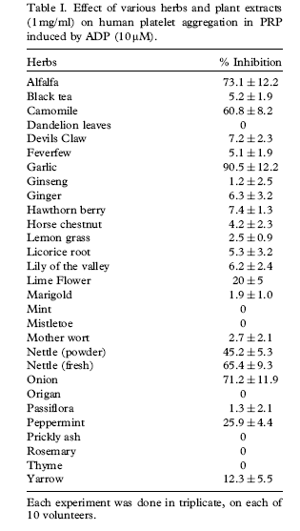
Antiplatelet effects

Slide 9
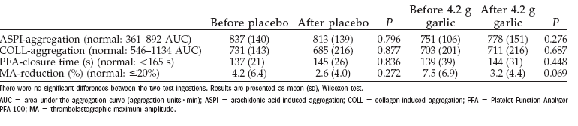
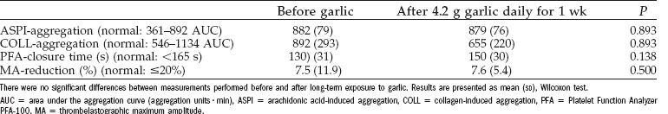
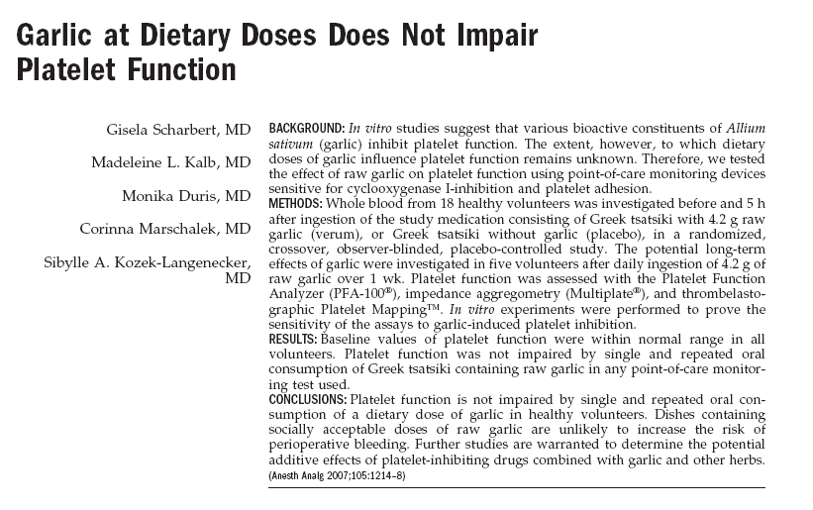
Antiplatelet effects of Garlic
Single dose
Repeated dosing

Slide 10
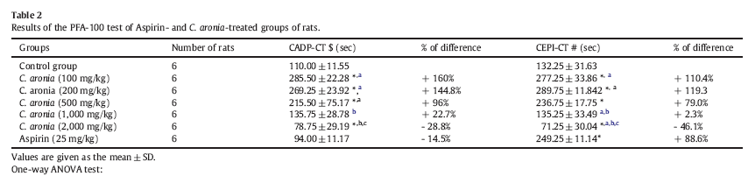
Antiplatelet effect of Hawthorn (Crataegus Aronia)

Slide 11
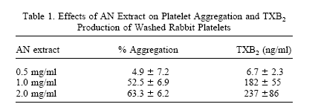
Procoagulant Effect of Areca Nut on platelet functions

Slide 12
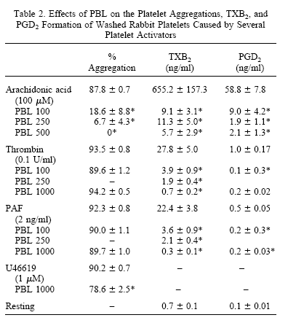
Antiplatelet effects of Betel Leaf extracts

Slide 13
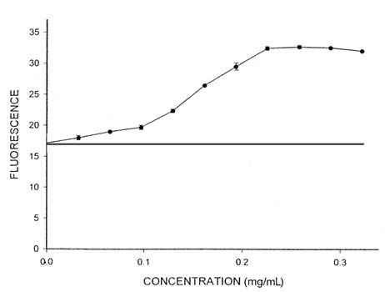
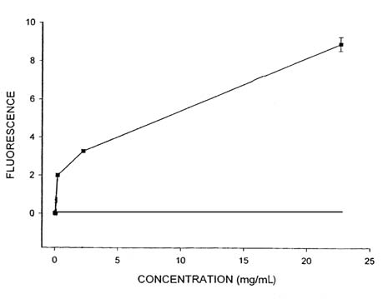
Fibrinolytic effects of Ginkgo biloba extract
Changes in fluorescence at different concentrations of
streptokinase
Changes in fluorescence at different concentrations of
Ginkgo extract

Slide 14
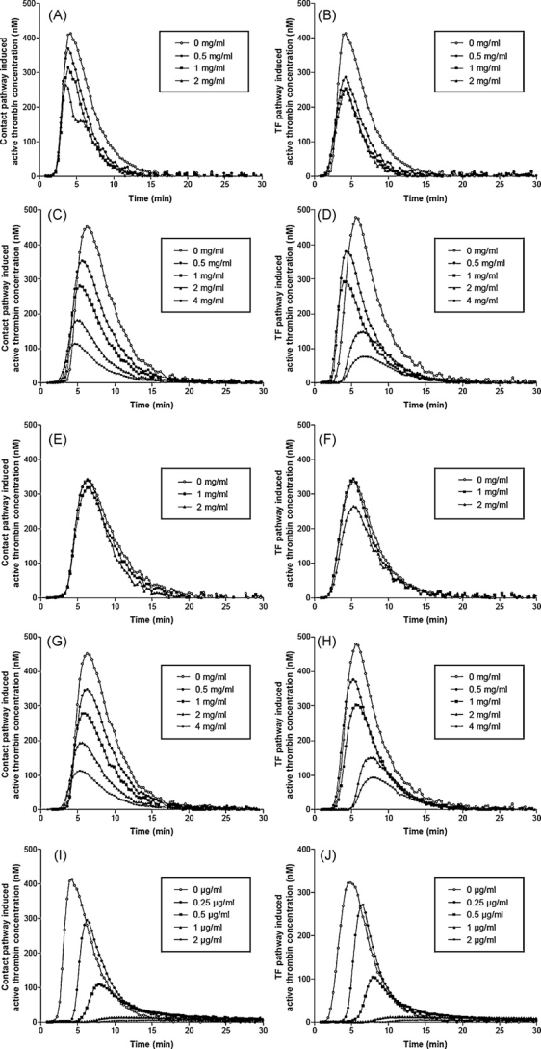
Effects of leaf extracts from Croton zambesicus Müell. Arg. On Thrombin generation
S. Robert et al. / Journal of Ethnopharmacology 128 (2010) 641–648

Slide 15
KU-PCAM Approach
CCMB→PCAM:establishment of pharmacognosy/drug discovery unit to research on traditional/alternative medication
Focus on :
Compiling of ethnobotany
Isolation and characterization of activity
Scientific testing-theme specific e.g blood clotting

Slide 16
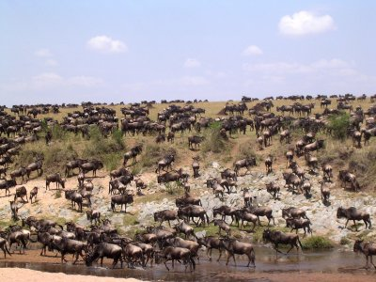
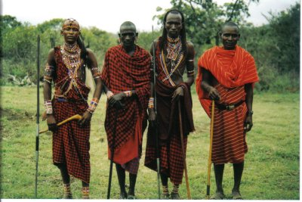
Maasai Mara, rite of passage¶

Slide 17
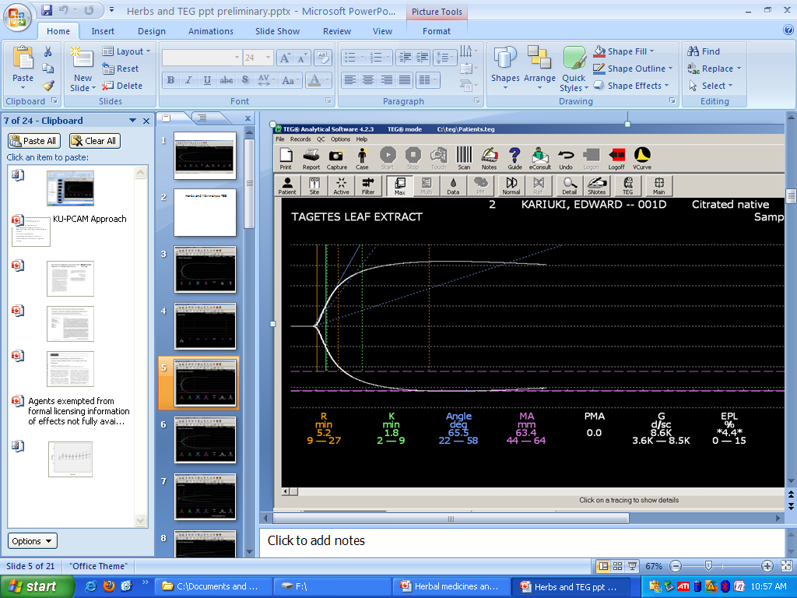
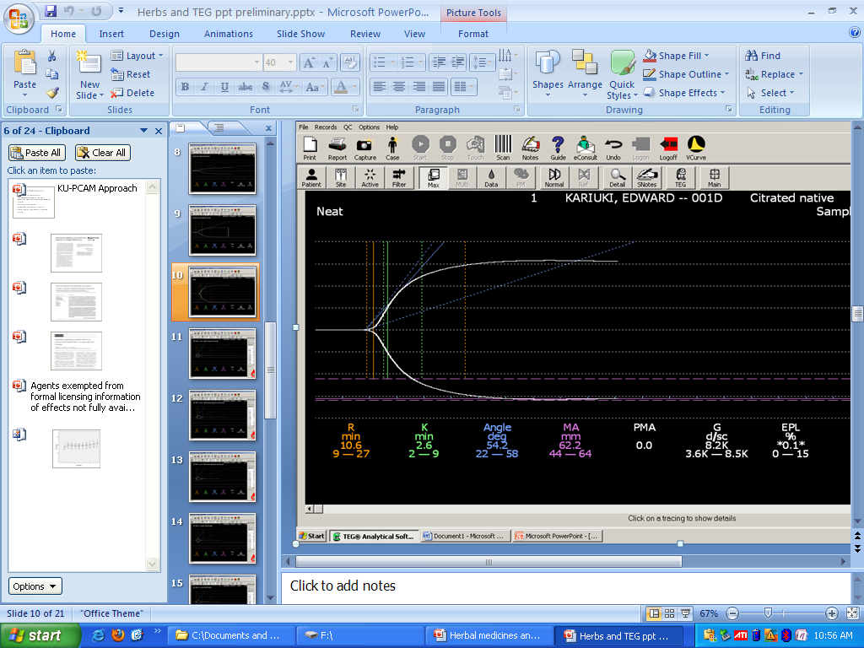
TEG herbal effects:Our data
Undiluted control
procoagulant

Slide 18
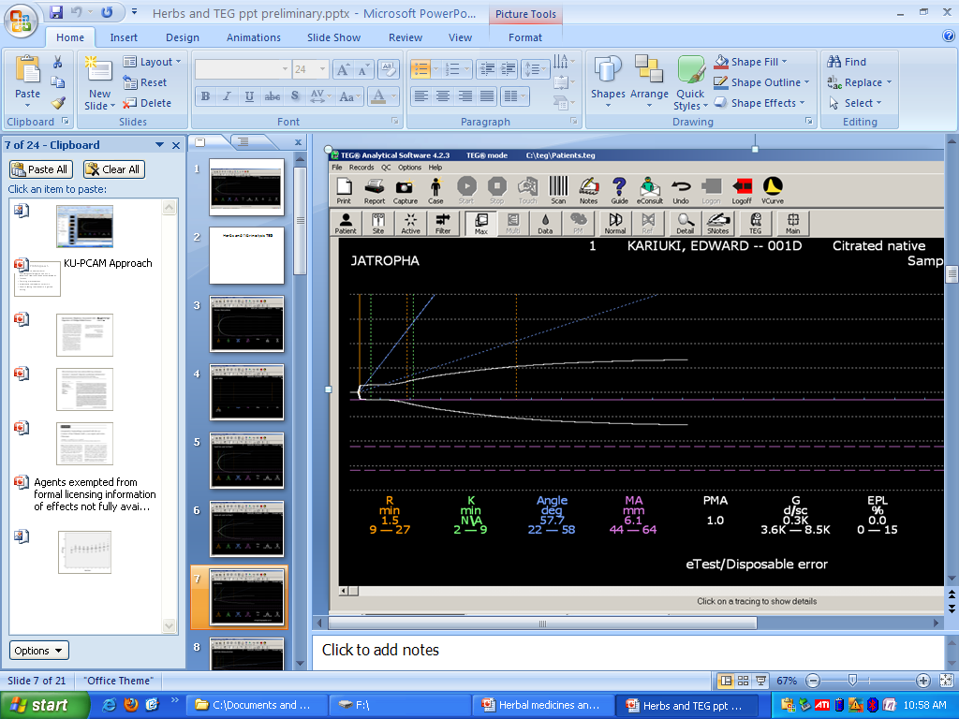
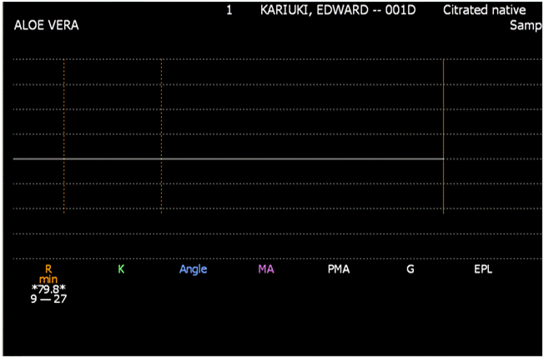
More examples
anticoacoagulant
ambiguous

Slide 19
Way forward
Currently, there is widespread use of herbal concoctions among surgical patients
There is huge knowledge gap on activity of herbal products on haemostatic system
Potential area of Research
Concerted collaborative efforts needed from all practitioners
Anaesthetists need to take history and understand concurrent use of herbal products

Slide 20
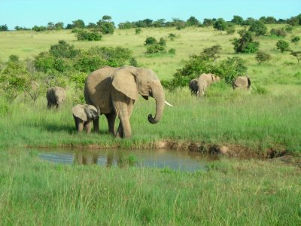
No wonder, Elephants take herbs, They are so healthy!

