Slide 1
Human Research Ethics: Focus On HIV/AIDS Research and Kenyan Perspectives
Dr G Ogweno
Medical Specialist
and Lecturer in Medical Physiology

Slide 2
Why Research?
Systematic enquiry-development, testing, evaluation, designing or contribution to generalizable knowledge
Audits-health care delivery and outcomes
Systematic investigation-material and sources to establish facts or new conclusions, hypothesis testing, expression of theories, principles and statements of relationships

Slide 3
Sources of misconduct in Academic research
Poor choices by faculty under stress and time pressure.
Inadequate mentorship
Academic stressors: output for promotion, lack of protected academic time, inadequate resources, poor understanding of institutional research processes
Non academic: high educational debt, competing economic reward expectations
Sheer fraud/ plagiarism/ criminality

Slide 4
Forms of unethical behavior/misconduct
Plagiarism/sloth
Forgeries and data fabrication/ falsification
Failure to seek IRB?ERC approval
Breach of existing legislation
Conflict of interest-financial, provider/ health care/ employer-employee relationship

Slide 5
General philosophies of Ethics
(i) Essentiality
(ii) Maximisation of public interest and of social justice
(iii) Knowledge, ability and commitment to do research
(iv) Respect and protection of autonomy, rights and dignity of participants
(v) Privacy, anonymity and confidentiality:
(vi) Precaution and risk minimisation
(vii) Non-exploitation
(viii) Public domain
(ix) Accountability and transparency
(x) Totality of responsibility

Slide 6
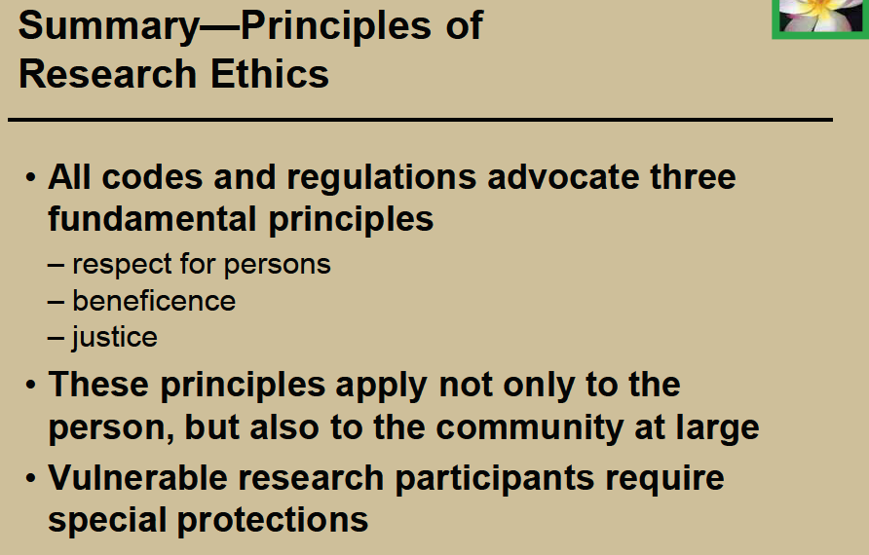

Slide 7
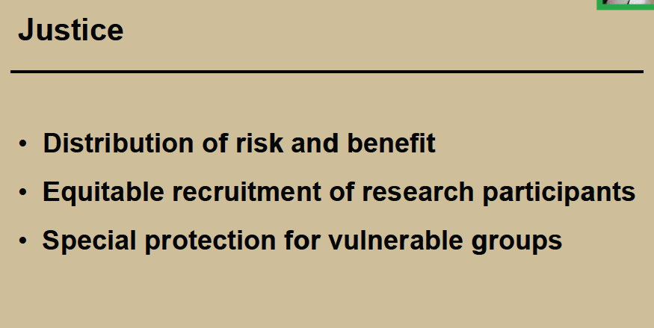

Slide 8
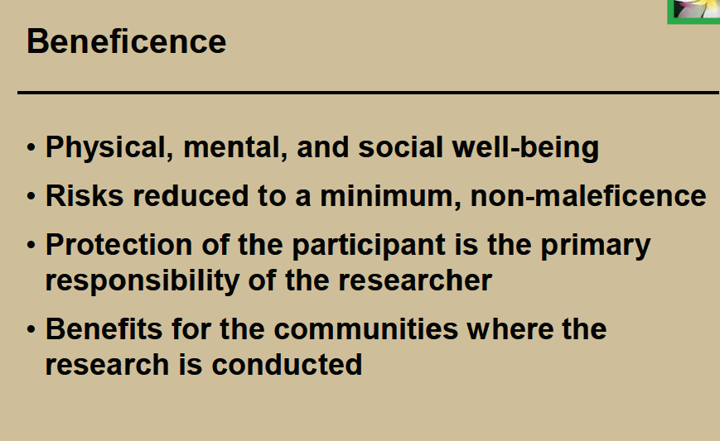

Slide 9
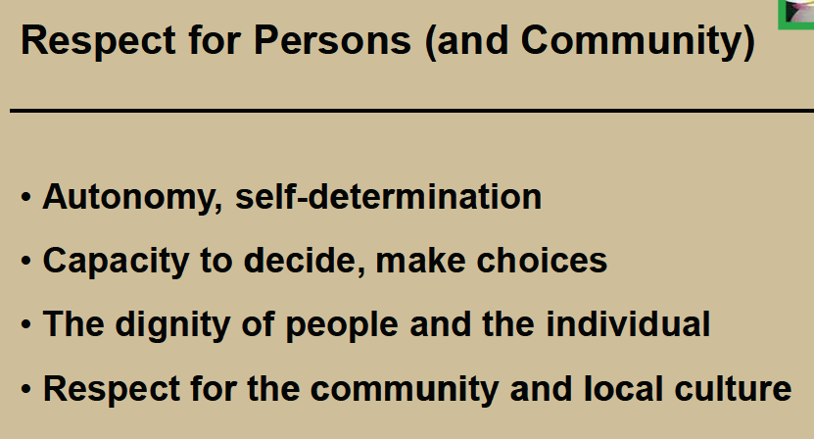

Slide 10
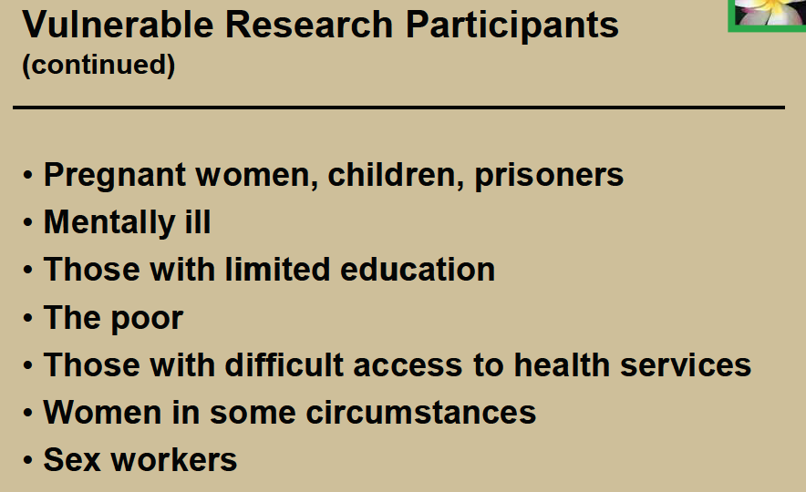

Slide 11
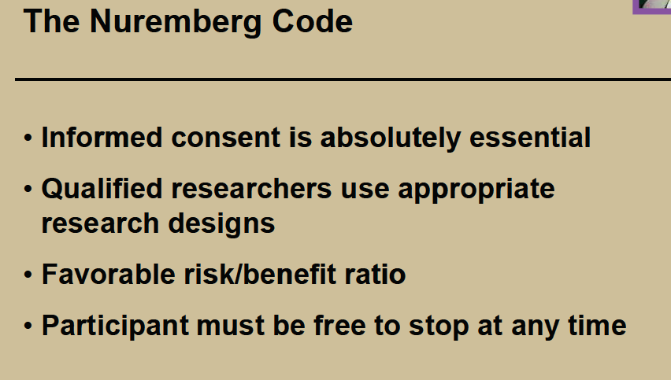

Slide 12
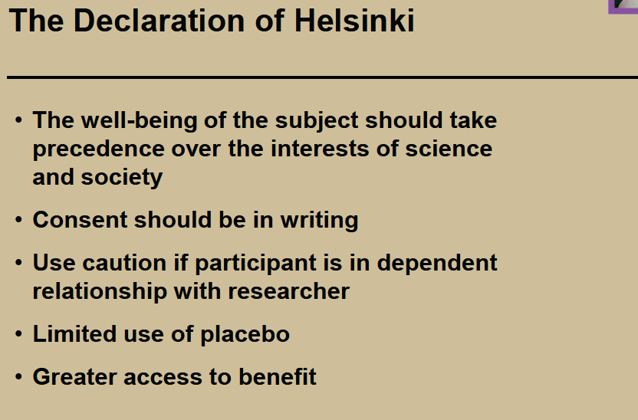

Slide 13
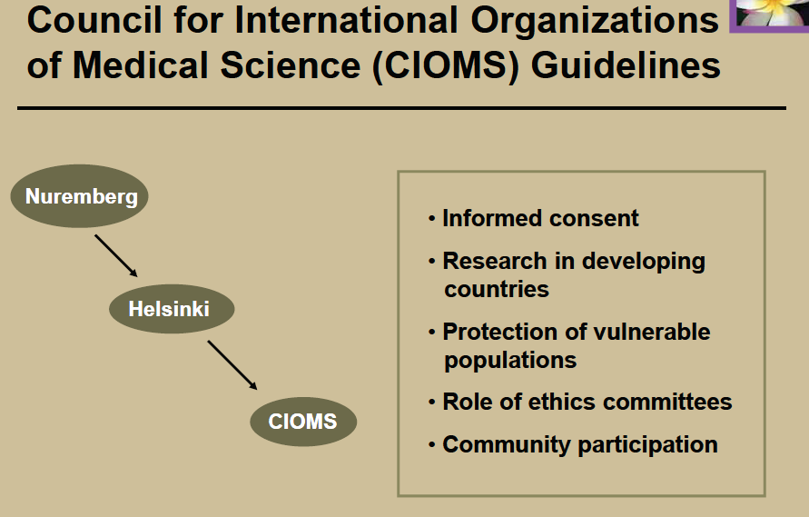

Slide 14
Requirements in biomedical research
Code of Deontology ( professional codes) e.g Hypocratic oath
ERC/IRB review and/or approval for conduct of clinical trials
Common law
Statutory requirements

Slide 15
UNAIDS guidance on HIV vaccine clinical trials
Early phase clinical trials should take place in sponsor (developed) countries, unless there are specific scientific and public health reasons to justify conducting such trials in a host (developing) country (Point 8).
Placebo-controlled vaccine trials are ethically acceptable as long as there is no known effective HIV preventive vaccine (Point 11).
All vaccine trial participants should have access to appropriate risk-reduction counseling and access to prevention methods (Point 14).
An appropriate monitoring system must be in place (Point 15).
Participants in HIV preventive vaccine trials should be provided with care and treatment for HIV/AIDS and its associated complications, with the ideal being to provide the best proven therapy, and the minimum to provide the highest level of care attainable in the host country

Slide 16
US NBAC recommendations on HIV clinical trials
All research sponsored or conducted by the United States must, at a minimum, meet the following criteria:
  prior review by an ethics review committee(s)
  minimization of risks to research participants
  risks of harm that are reasonable in relation to potential benefits
  adequate care of and compensation to participants for injuries directly sustained during research
  individual informed consent from all competent adult participants in research
  equal regard for all participants
  equitable distribution of the burdens and benefits of research.
Ethics review by the host country that meets these standards should be sufficient, and steps should be taken to determine when a host country meets these standards. If a host country does not meet these standards, review should be conducted by both the host country and the appropriate U.S. ethics review committee.
Only those studies that are responsive to the health needs of the host country are permissible.
Members of any control group should be provided with an established effective treatment, whether or not such treatment is available in the host country. An alternative design that would not provide such treatment requires strong justification based on the health needs of the host country.
Community representatives should be involved throughout the design and implementation of research projects.
Researchers, in consultation with community members, should develop culturally appropriate ways to meet the standard of voluntary informed consent. This may include culturally appropriate methods of disclosing information, seeking permission for research participation from a community representative or family member, and assessing participants' understanding of information disclosed. However, where such permission is sought, it may not substitute for individual informed consent.
U.S. research regulations should be amended to permit ethics review committees to waive the requirements for written and signed consent documents in accordance with local cultural norms.
Researchers and sponsors in clinical trials "should make reasonable, good faith efforts" to ensure continued access for all participants to experimental interventions that have proven effective
Where possible, researchers should negotiate agreements to provide interventions that are proven effective to others within the host country prior to starting the research and should discuss plans to provide such access in their research proposals for evaluation by ethics review committees.

Slide 17
Kenyan National Medical research framework
National Council for Science and Technology oversight role for all researches
Medical procedures anchored in Kenya Medical Practitioners and Dentists Board
Registration and approval for medicinal agents and devices by Pharmacy and Poisons Board
Evaluation of training and certification by Ministry of Education

Slide 18
Roles of local ERC/IRB
Ensures that the research:
Design and objectives are scientifically sound
Question is relevant to the local environment
Respectful of local cultures and practices
Compliance with legislations and statutes
Data monitoring and evaluation
Conduct, training and competence of personnel
Review of human volunteers, human tissues, identifiable human data

Slide 19
Roles of Statutory bodies
Inspection of research sites and audit of research conduct
Safety monitoring
Ordering for termination or investigation of misconduct
Receiving complaints about misconduct
Recommending criminal prosecution
Periodic surveillance of adherence/ misconduct

Slide 20
Research Situations requiring IRB review
All human research
Submission of manuscripts for publication
Permission to conduct audits and its publication
Case reports involving experimental devices, drug or methods
Human intervention research=no exceptions
Determination for requirement of informed consent or its waiver

Slide 21
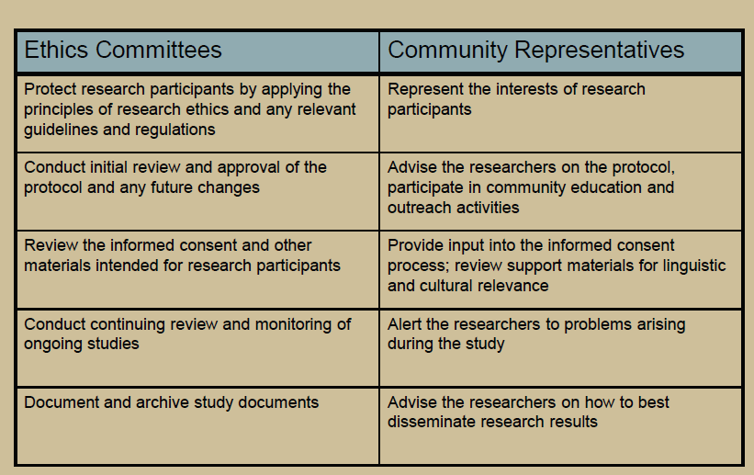

Slide 22
Key issues in HIV research
Biology of disease
Diagnosis-testing methods
Consequences of negative/ positive tests
Treatment/ care
Global vs local perspectives
Sponsored research

Slide 23
Social and Behavioural Research in HIV/AIDS
1. Understanding and response to HIV/AIDS
2. Safer sexual practices and other modes of risk reduction
3. Biological and societal vulnerabilities to HIV/AIDS
4. Economic impact of HIV/AIDS
5. Disclosure, stigma and discrimination
6. Mental health issues including alcohol and substance abuse
7. The rights of positive people
8. Prevention programmes and interventions

Slide 24
Ethical Issues in HIV/AIDS Research
Dealing with biases and fears
Identity conflict: between roles of researcher and interventionist
Dealing with confidentiality in interviewing and of the data
Process of getting informed consent from the respondents
Selection of respondents
Addressing the needs of the poor and marginalized in the process of research=human rights
Relevance of research to communities being studied
Identification of stakeholder

Slide 25
Emerging Ethical Dilemmas in HIV Research
Exceptions to informed consent and prenatal HIV testing
End of Life Issues
Research Ethics vs Research Designs
Conflict of interest
Vaccine research and clinical trials=use of placebo
International collaborative research
Blood component removal , storage and transportation across borders
Long term effects and compensation

Slide 26
Ethical Questions in HIV intervention researches
Is use of placebo permissible?
Is the study design appropriate to demonstrate efficacy?
Is local REC review and approval necessary?

Slide 27
The Kenyan HIV/AIDS research experiences
Research in illegal groups-prostitutes, homosexuals
Alleged treatment regimes: Pearl Omega, Polyatomic Apharesis, Kemron, Immunex
KAVI –Oxon-UoN saga
Legal framework for monitoring and evaluation of protocols
Unethical research in vulnerable groups-case of Nyumbani Home

Slide 28
Lessons learnt
Ethics of research were grossly abused
ERC approval generally ignored or ineffective
Substances in question oftenly not registered as required by law
Legislative coverage on research generally, HIV vaccine in particular incomprehensive and inadequate
Protection to vulnerable and stigmatized groups is inadequate

Slide 29
Conclusions
Need for legal reforms incorporating legal and ethical rules governing HIV research
Reconsideration of legal position of commercial sex workers and Homosexuals
Provision of post-review monitoring and evaluation to ensure compliance with requirements
Need to bridge the gap between industrialized and third world standards of research for universality of applicability

Slide 30
References
1. Rachier A. Ethics in HIV/AIDS research in Kenya: The cases of Immunex, Kemron, Pearl Omega and Polyatomic Apharesis (WDDS treatment). Int Conf AIDS 1998;12: 965 (Abastract no. 474/44140)
Rachier A. Ethical and Legal Issues in HIV vaccine research and development in Kenya-The case of the Kenya AIDS vaccine initiative (KAVI) and University of Oxford collaborative research in Nairobi. Int Conf AIDS,2004 jul 11-16 (abastract no MoPeE 4208)
Leslie E W, Bernard Lo. Ethical Dimensions of HIV/AIDS. HIV inSite Knowledge Base Chapter. University of California, San Francisco, Aug 2001
Boberto Rivera, David Borasky. Research Ethics Training Curriculum, 2nd Edn. Family Health International , 2009. ISBN 1-933702-33-8
Vimla V. Nadkarni. (Ethics of AIDS research in a developing country - balancing power in disguise. Reprint of the address given by Dr M.W. Makgoba at a plenary session of AIDS 2000
Hoffart J, Teichmann A, Wessler I. Biomedical Research in Germany: The Role of Ethics Committee and State Medical Association (Editorial). Anesth Analg 2011;112(3): 501-503
Forstemann U. Research Oversight in Germany: Safeguards and Shortcomings (Editorial). Anesth Analg 2011; 112(3): 504-506

