Slide 1
The Kenya Water Towers Agency Water Catchments and Storage Systems: The Mau Catchment Dilemma
Simon M Onywere
Capacity Development and Consultancy Services
Kenyatta University
Department of Environmental Planning and Management
onywere.simon@ku.ac.ke
onyweres@gmail.com

Slide 2

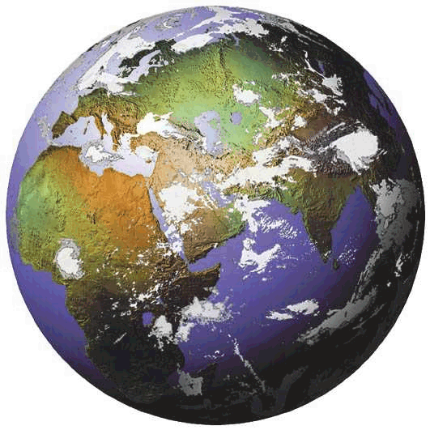
We Live in Two Worlds
The Natural World
The Constructed World
Self-Regulating, self-sustaining
interconnected ecosystems
Getting Degraded &
need to be Managed
The two are Increasingly in Conflict

Slide 3
The Context of sustainability
Seeing the Whole
Managing Development
Ecosystems
Flows
Patterns
Linkages
Trends
Value
Watersheds
Supporting capacity
Livelihood systems
Impacts on Neighborhoods
Regional effects

Slide 4
The Context of sustainability
People
(Humanity)
Social
Economic
Ecology
Bearable
Equitable
Sustainable
Viable
Planet (Earth - Environment)
Profit
(Development)
Environmental Management Paradigm for Sustainability

Slide 5
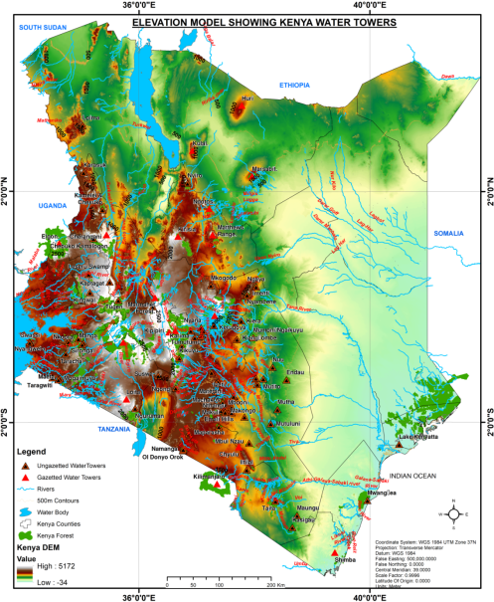




Dilemma of a Nation - 2018
Locusts (Loima Turkana)
Yellow Fever (Wajir)
Cholera (16 Counties)
Natural Disasters
Energy
Fall Army Worms (Maize Growing Areas)
Climate Change
Migration
Loss of Nature
Urbanization
Dengue fever (Kwale)
Biodiversity
Population
Inequality
Pollution
Mudslides (Murang’a)
Social Conflict
The Belt of fractures (South Rift)
Water
Consumption
Floods (All-over) and a
Dam failure in Solai

Slide 6
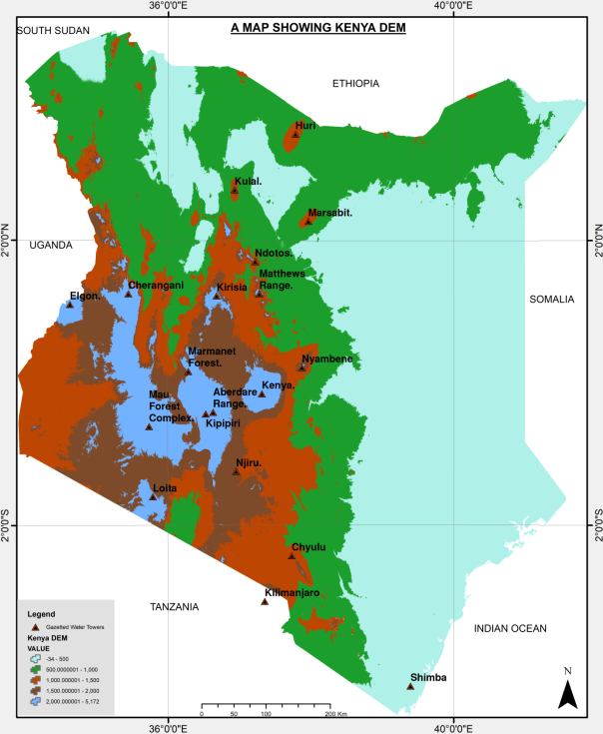
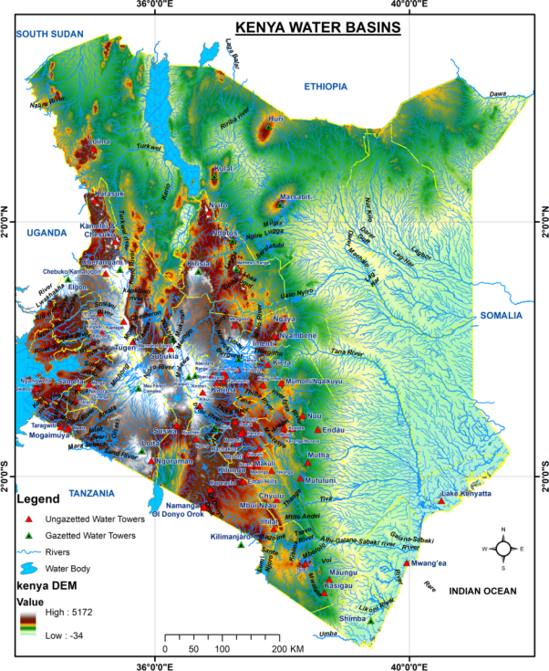
The Altitude zones of Kenya
Altitude Region | Area Km2 | Per cent
Below 500m | 244196 | 41%
501-1000m | 178897 | 30%
1001-1500m | 79781 | 13%
1501-2000m | 59164 | 10%
Above 2000m | 34403 | 6%
Most of Kenya is <500 asl
Areas >2000m asl receive 1000mm of rainfall and are the water tower area
Psalm 24: 1-4

Slide 7
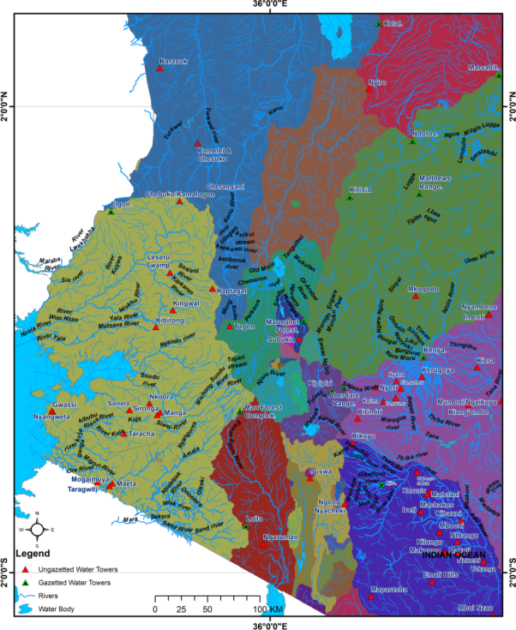
Kenya’s River Basins in Rift Valley and Lake Victoria Regions.
The rift valley drainage basins of lakes Magadi, Naivasha, Nakuru, Bogoria and Turkana are structurally controlled and
Elongate in the North-South direction

Slide 8
Defining the Water Tower
“Water towers refer to upland areas (hills, plateaus and mountains) whose climate, geology, tectonics, substrate, land cover/use and hill-slope morphological characteristics support reception, infiltration, percolation and storage of rainfall (or any form of precipitation) on the surface, in the soil, rock and aquifers that, apart from surface runoff, is a gradual source of water through springs, rivers and swamps in a drainage basin (also called catchment [UK] or watershed [US])”

Slide 9
The Mau Complex Area
Mau Complex forms the Western Escarpment of the Great East African Rift Valley
It is a highly drainage dissected, uplifted fault block that is a water tower feeding Nyando, Sondu, Mara (L. Victoria), Molo (L. Baringo), Ewaso Ngiro South (L. Natron), & rivers recharging Lake Nakuru
The substrate is composed of porous, permeable surfaces of volcanic ashes, pumiceous pyroclastics and faulted lava and tuff on which percolation of runoff, lead to potentially high groundwater storage
Rainfall varies between 1000 - 1400 mm
The formally heavily forested area’s functions included protecting the water tower, purifying water and air, regulating river flows, providing ecosystem services

Slide 10
STATUS & CHARACTER OF MAU COMPLEX FOREST
Due to rapid economic, social, political, institutional, technological and environmental changes the Mau Complex the forest has greatly been compromised
The current loss of forest is a significant problem expressed in terms of the impacts on ecosystem functions e.g. the hydrological cycle and the flow regimes of rivers in the area
The occurrence, distribution, circulation of water, the quality of water & the timing of discharge have been greatly affected Why?

Slide 11
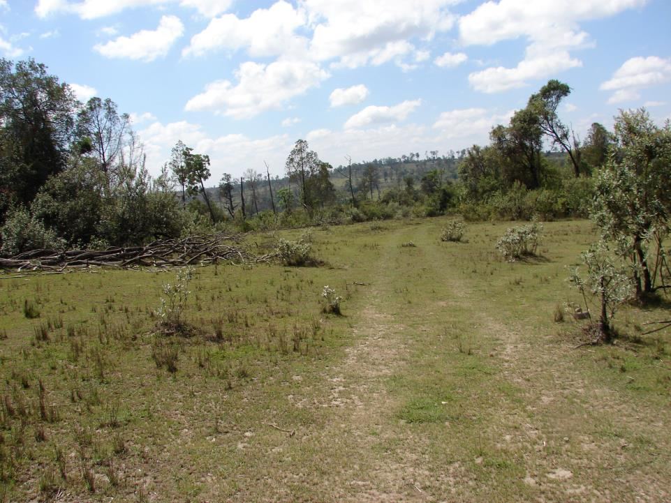
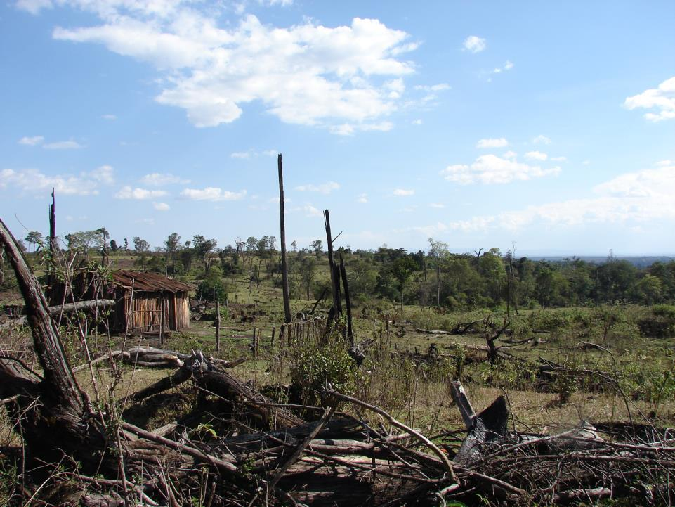
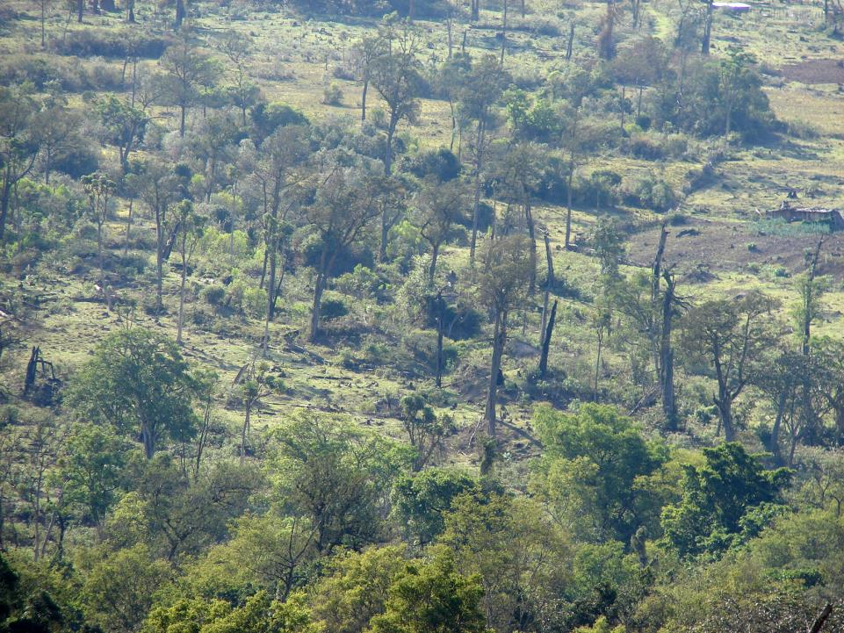
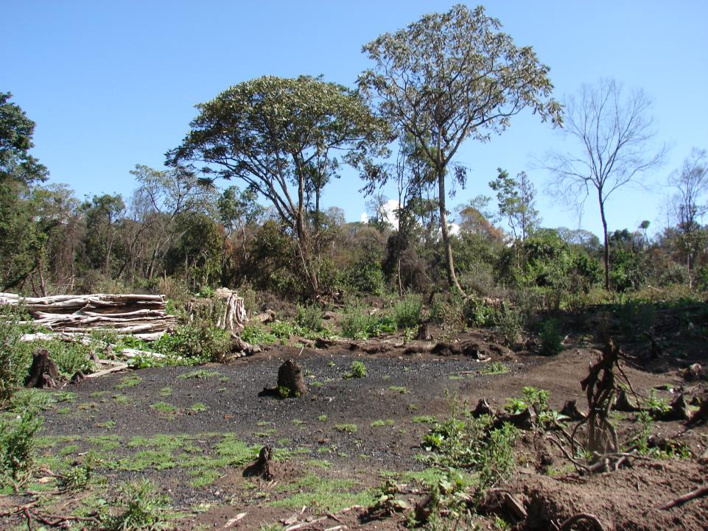
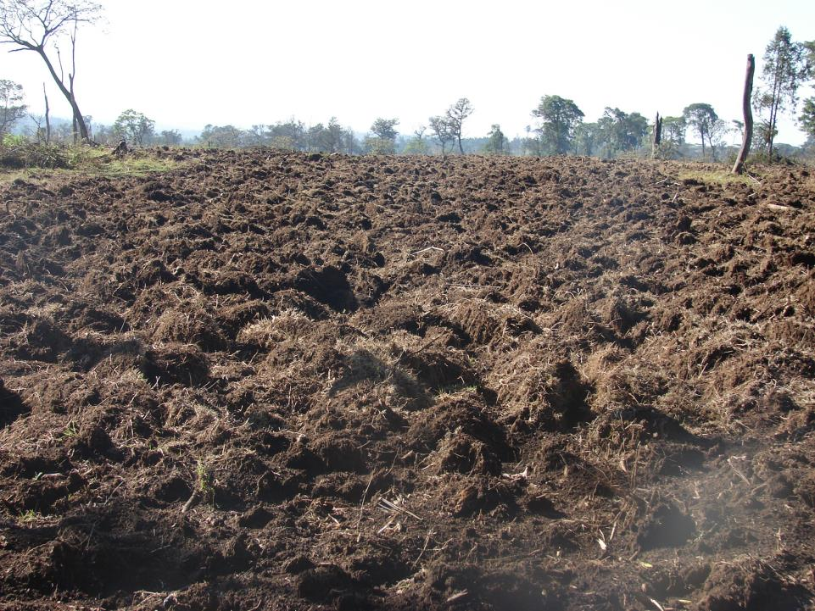
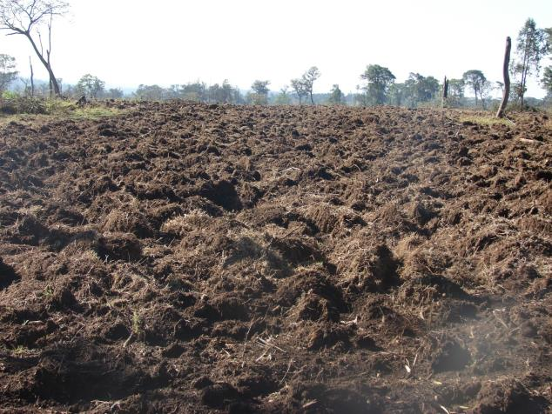

Slide 12
The Mau Catchment Dilemma
Analysis of time series satellite images shows that since 1985 Mau Complex forest has persistently been removed and replaced by agricultural land and settlements
The destruction of the forests has effectively threatened hydrological functions and endangered water supplies for a large proportion of the population downstream
It is also causing severe siltation, flooding, and extreme low flows during the dry season
Despite the campaigns has anything changed?

Slide 13
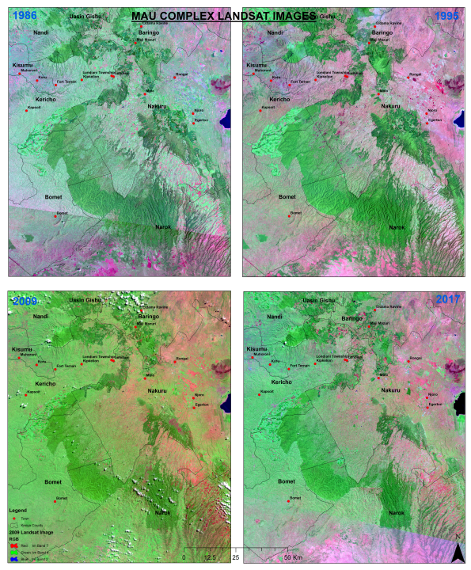
Consequence of Human Impacts on the Mau Complex Forest Ecosystem – Conflict over the Cut-line
RGB – Green
RGB - Red

Slide 14
Land Use | 1986 | 1995 | 2009 | 2017 | 1986-2017 Changes (Km2) | 1986-2017 % Change
Farmlands | 8589 | 8283 | 10614 | 9809 | 1220 | 14%
Forest | 4986 | 4975 | 2752 | 2603 | -2383 | -48%
Plantation | 390 | 790 | 356 | 1057 | 667 | 171%
Settlement | 105 | 41 | 260 | 392 | 287 | 273%
Water Body | 34 | 25 | 30 | 44 | 10 | 29%
Bare land | 30 | 19 | 121 | 228 | 198 | 660%
Total | 14133 | 14133 | 14133 | 14133

Slide 15
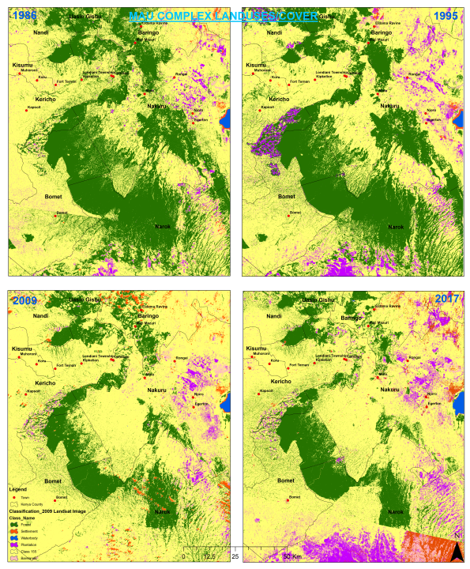
The Extent & Oscillation of Forest degradation is evident

Slide 16
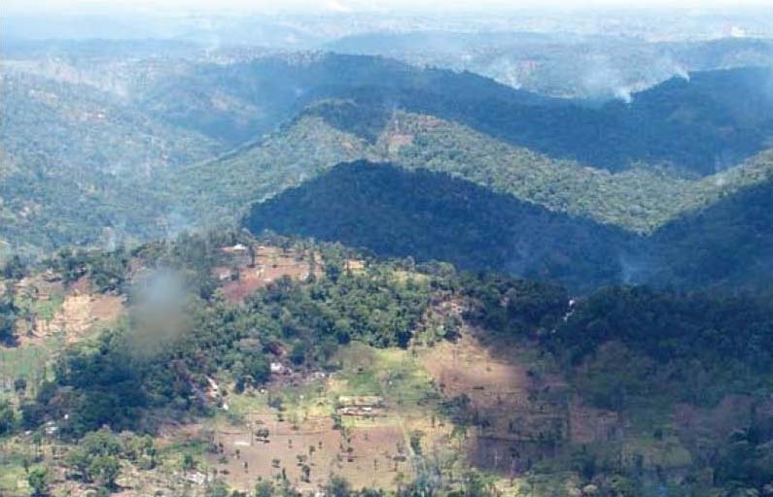
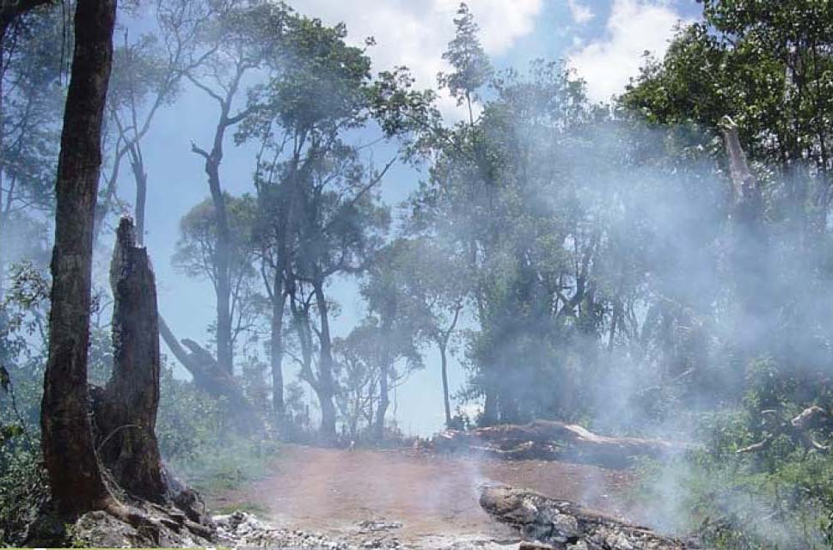
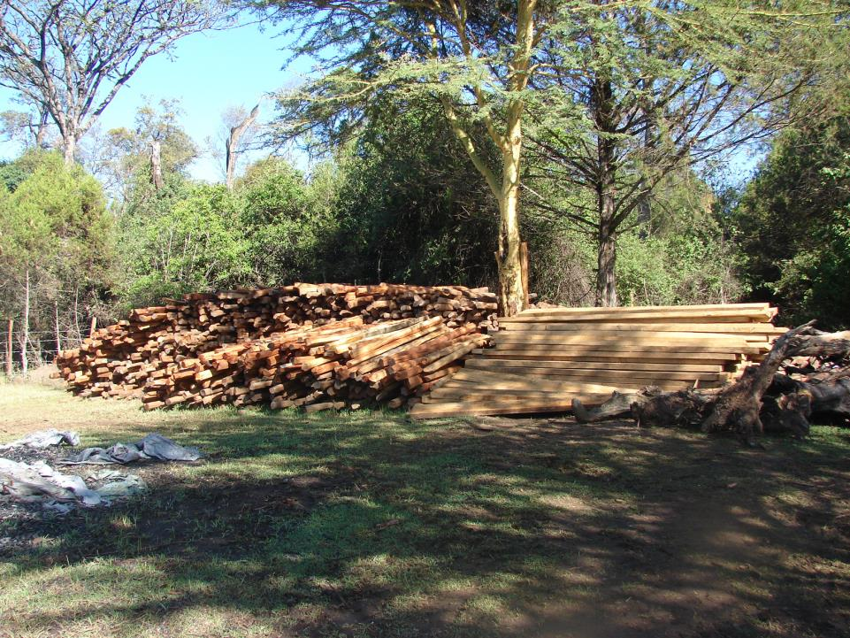

Slide 17
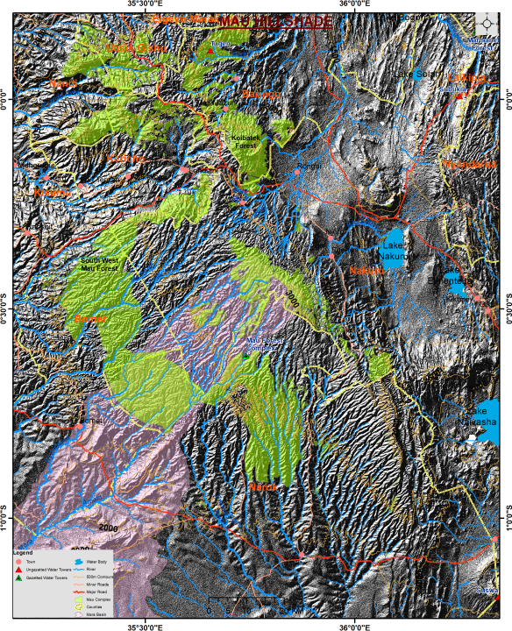
The DEM of
Mau Water Tower

Slide 18
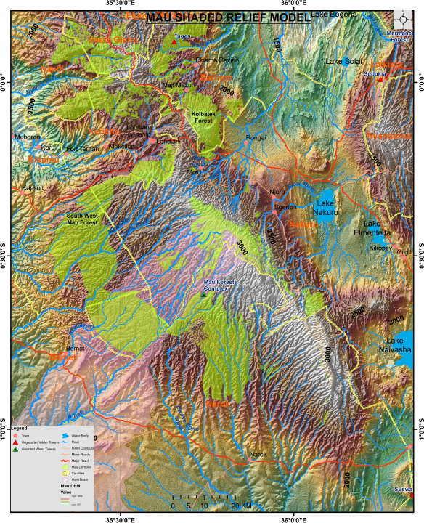
The Shaded Relief
Mau Water Tower
The Mau Basins

Slide 19
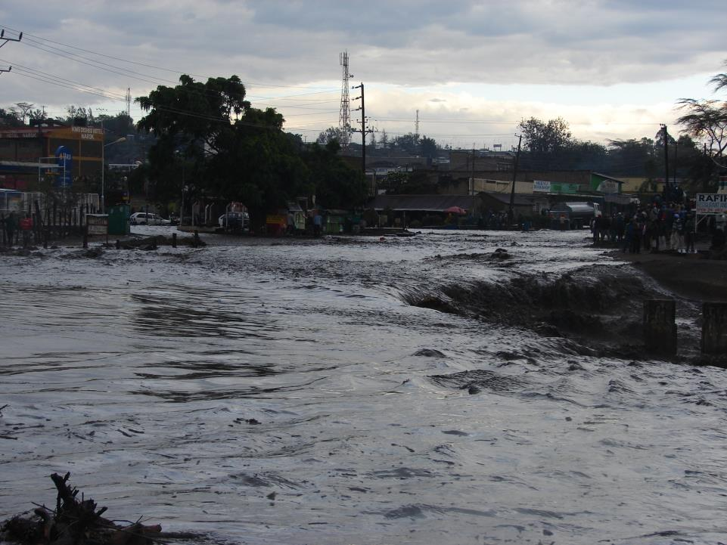
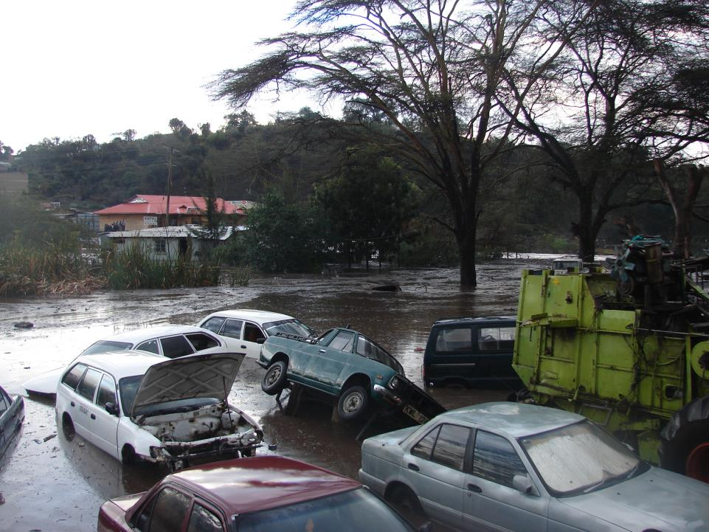
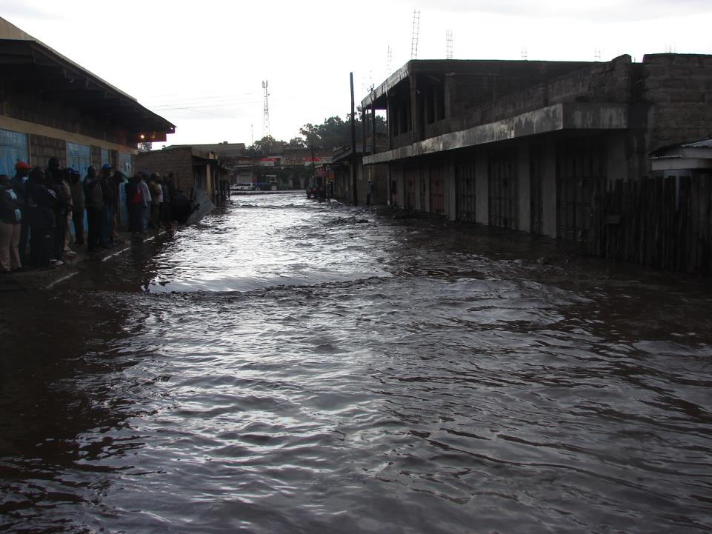
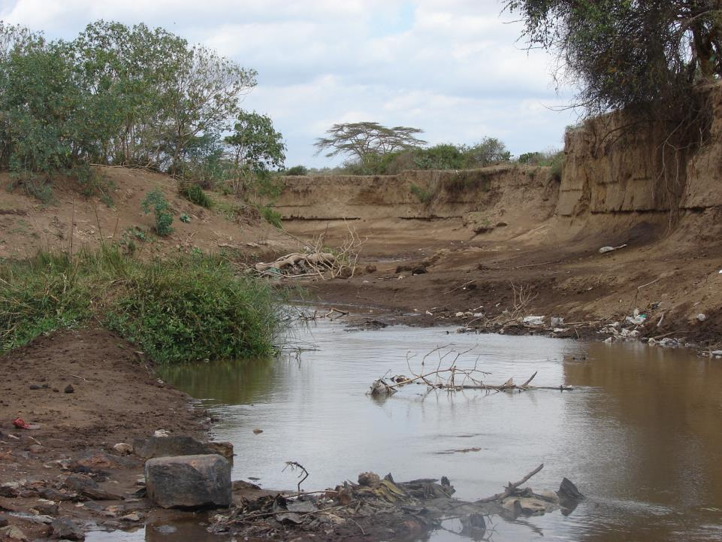
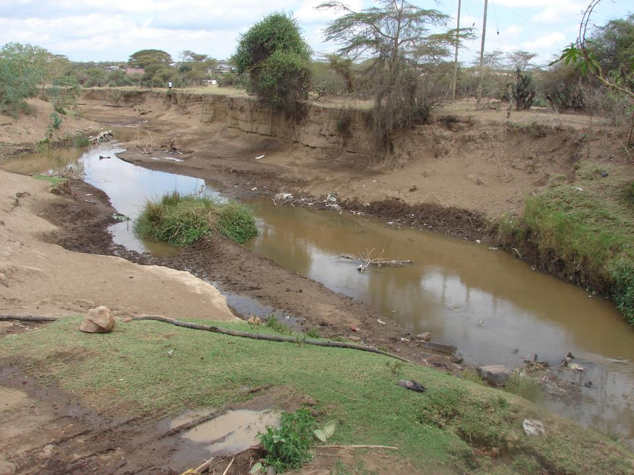
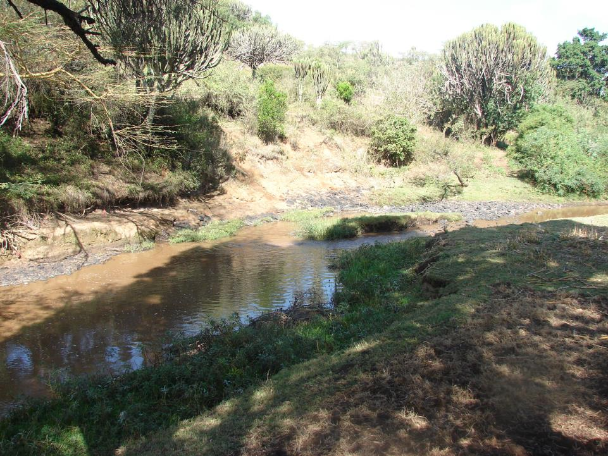
The consequence is Evident

Slide 20
A participatory catchment / land / resources / water management plan
Require Spatial Thinking at all levels
OBSERVATION
What do you see?
(where?)
INTERPRETATION
What does it mean?
(use, impacts)
APPLICATION
How do I respond?
(interventions)
THE GOAL
Changed lives
(sustainability)
Example of the Mara Ecosystem

Slide 21
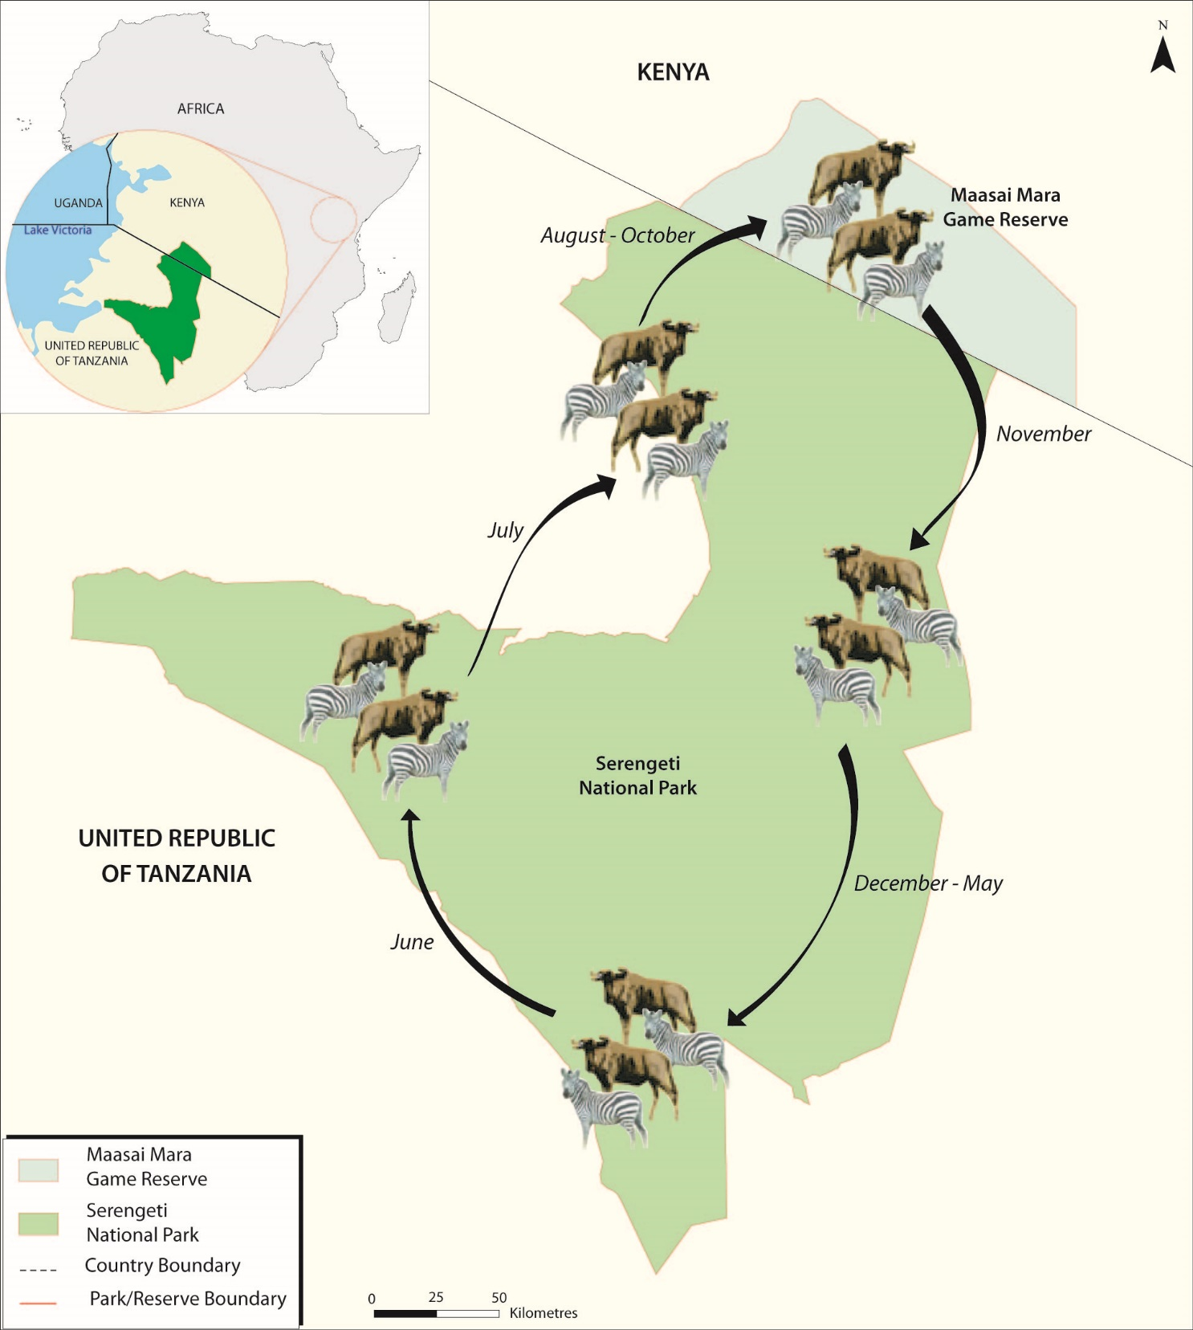
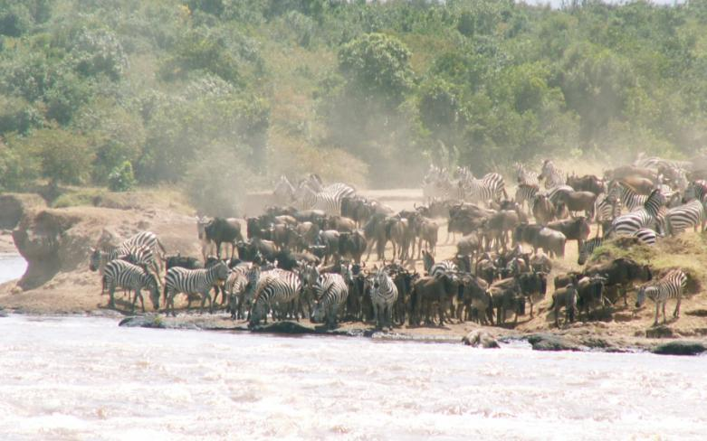
The Great Mara-Serengeti Migration
1.4 Million Wildebeest, 500,000 zebra
A challenged ecosystem

Slide 22
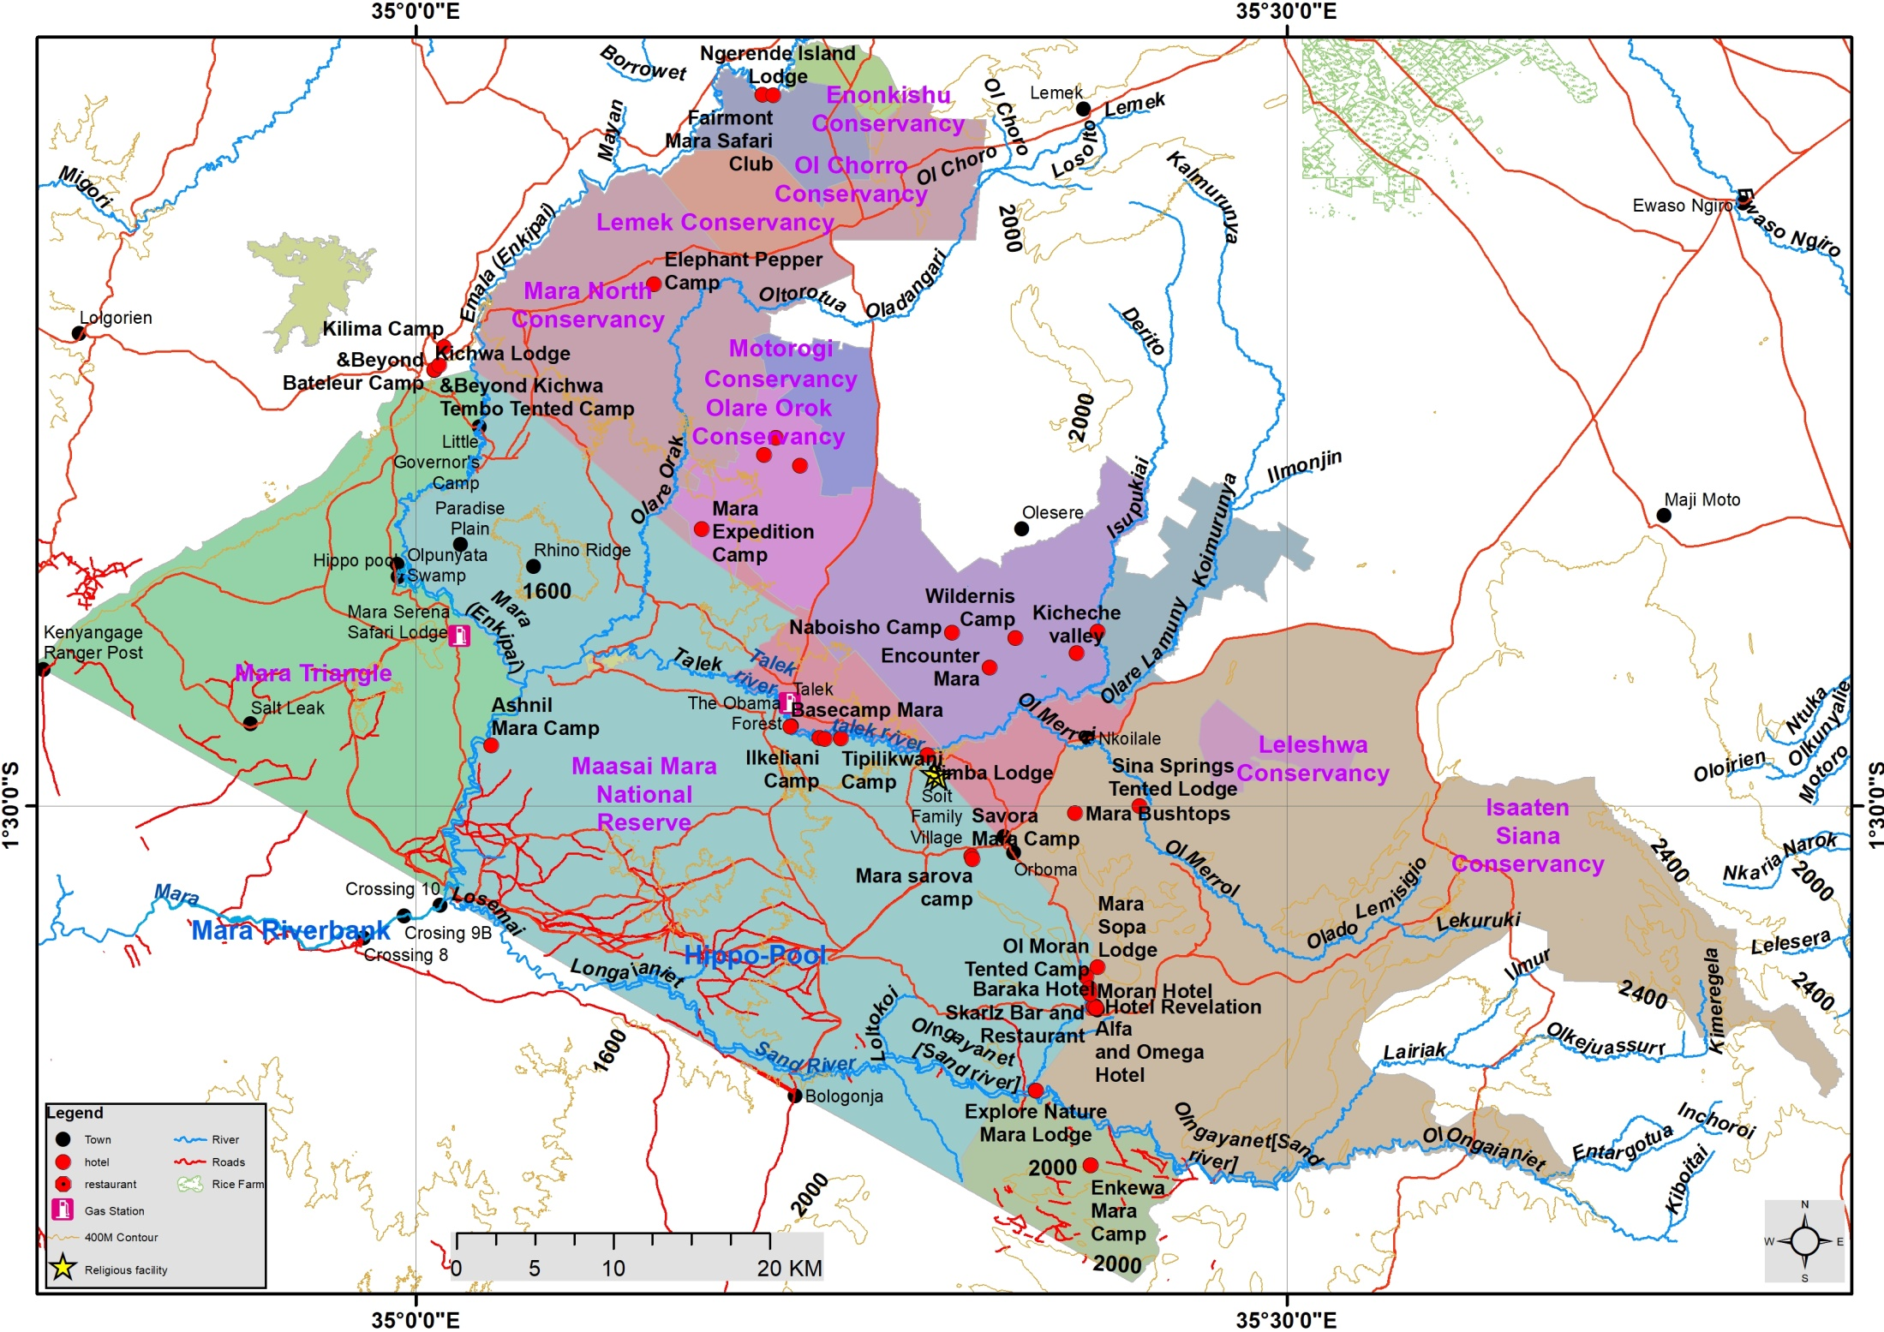

Slide 23
Name | Area (Km2)
Maasai Mara National Reserve | 1522
Isaaten Siana Conservancy | 952
Mara Triangle | 477
Mara North Conservancy | 341
Naboisho Conservancy | 210
Talek Communal Land | 107
Ol Deriskei Conservancy | 99
Olare Orok Conservancy | 94
Ol Kinyei Conservancy | 77
Lemek Conservancy | 55
Ol Chorro Conservancy | 53
Motorogi Conservancy | 48
Leleshwa Conservancy | 27
Leleshwa Conservancy | 27
Enonkishu Conservancy | 21
Sum Area | 4110

Slide 24
Distribution infrastructure
Resource development
Bulk infrastructure
Connector infrastructure
Internal infrastructure
Distribution reservoir
Connector pipeline
Bulk water pipeline
Internal pipe network
Water treatment works
To other settlements
Dam
Pumping station
Collector sewer
River
Waste water treatment works
Sewerage
Assimilative capacity of receiving water body
Outflow sewer
Treated effluent outflow
Impacts on aquatic environment and down-stream water users
Sewerage pump station
Sewerage reservoir

Slide 25
Water Source and Supply System
Water Supply Services
Transfer from sources, treatment works, pumping and piping
Water supply chain
Collector piping, sewerage reservoir, treatment works
springs, rivers, swamps, lakes, dams, and groundwater
Water resources
Quality Water Distribution infrastructure
Distribution reservoirs, connectors, piping network
Outflow impacts on environment & downstream users
Sewerage Effluent management
Water eco-Protection

Slide 26
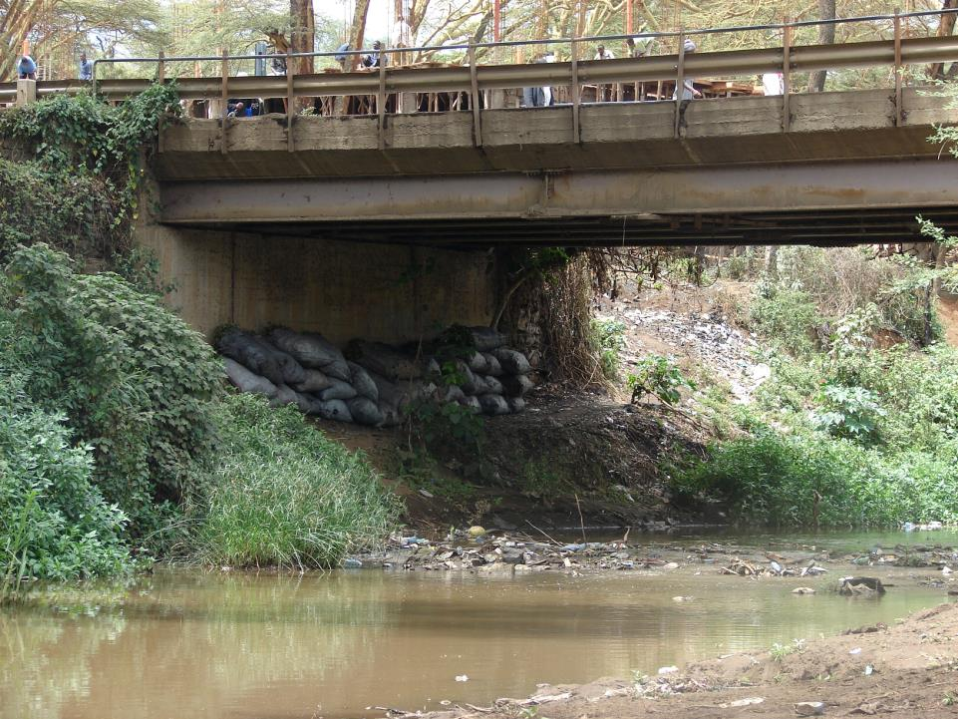
onyweres@gmail.com
onywere.simon@ku.ac.ke
Thank you

