Slide 1
Fluids and Blood Transfusion practice in Surgery
Dr G Ogweno

Slide 2
Aims of Infusion therapy
To replace third space losses
To restore plasma volume
To restore/enhance oxygen transport
To replace/restore plasma composition-electrolytes, oncotic pressure
To augment haemostasis

Slide 3
Plasma Volume therapy
Colloids
Blood+/components
Natural:
Albumin
Artificial:
gelatin
Dextran
Starch
Whole blood
Packed red cells
FFP
Plasma Proteins(bioplasma)

Slide 4
Choice of Volume therapy
Whichever one chooses:
1.Choose the fluid for the correct purpose.
2.Know the composition of the fluid chosen.
3.Be aware of the risks and benefits of the particular fluid chosen

Slide 5
Properties of the “ideal plasma substitute
Distributed in intravascular compartiment only
Readily available
Long shelf half-life
Inexpensive
No special storage or infusion requirements
No special limitations on volume that can be infused
No interference with blood grouping or cross-matching
Acceptable to all patients & no religious objections to its use.
Iso-oncotic with plasma
Isotonic
Low viscosity
Contamination easily detected
Half-life should be 6-12 hours
Should be metabolised or excreted, not stored in body

Slide 6
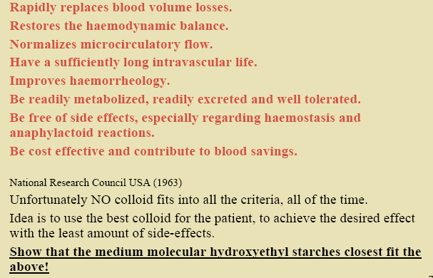
What is the Ideal Colloid?

Slide 7
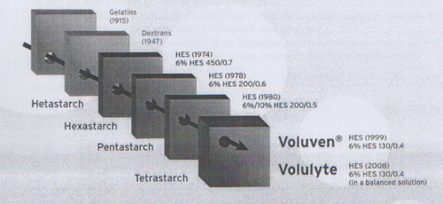
Historical Evolution of Artificial Colloids

Slide 8
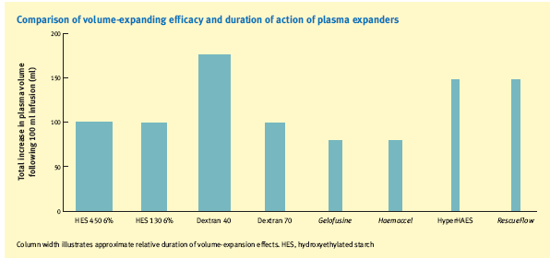
Volume expanding efficacy of Colloids

Slide 9
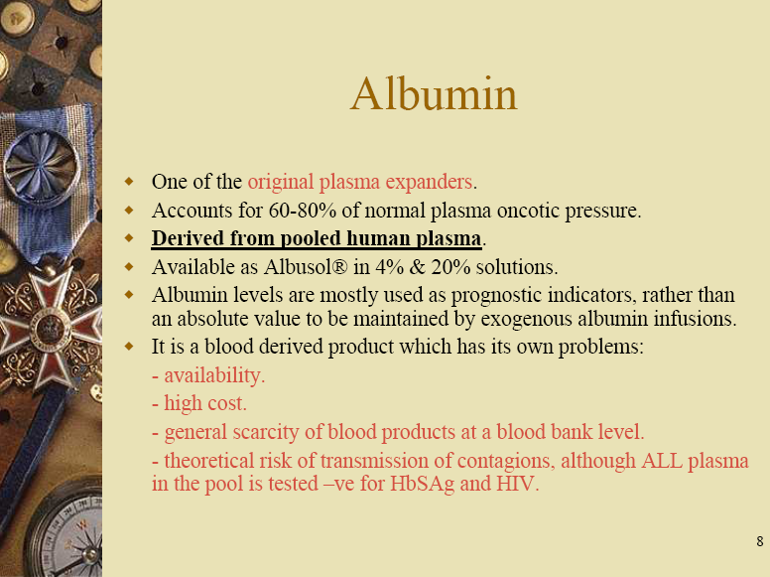

Slide 10
Gelatins
Advantages
Disadvantages
Small MW=rapid excretion
Preservative free
Only 1% metabolized
No storage in RES
Minimal effect on coagulation
Bovine source(collagen)=disease transmission
Rapid clearance= continuous infusion, more volume
Anaphylactoid reactions

Slide 11
Dextrans
Advantages
Disadvantages
Decreased:
blood viscosity,
platelet adhesiveness,
RBC aggregation
Clinical uses:
plastic surgery,
carotid end arterectomy
prophylaxis of thrombembolectic phenomenon
Briefer volume expansion
Highest incidence of anaphylactic reactions
Interferes with blood grouping , clotting, antiplatelet
Worsen renal failure
Hyperviscosity syndrome in renal tubules

Slide 12
Hydroxyethyl Starches (HES)
Introduced in 1960s to overcome drawbacks of Dextrans, albumin and gelatins
Derived from natural plant starches-waxy maize or potato
Modified amylopectin
Progressive reduction of MW and molar substitution over years

Slide 13
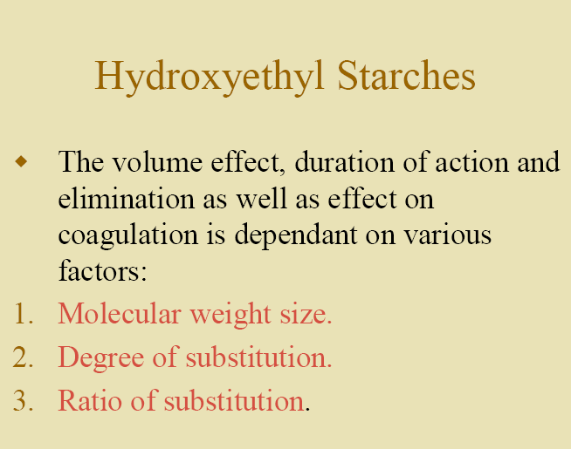
Physicochemical characteristics of HES

Slide 14
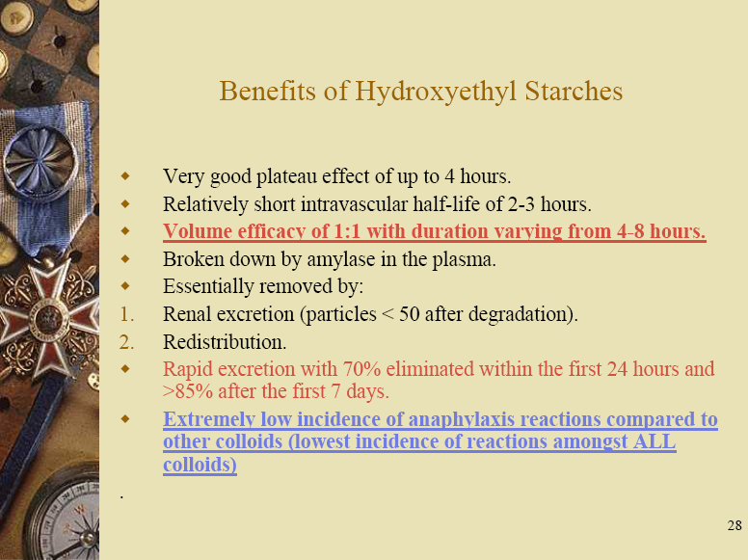

Slide 15
Achievement of Desirable HES features
Reduction in side effects:lower MW and lower degree of substitution e.g 130/0.4 (Voluven/volulyte)
Good duration of effects: high pattern of C2/C6 substitution ratio
Currently available products: 6%/130/0.4/9:1=Voluven (in Normal saline) or volulyte (in balanced salt solution)

Slide 16
Potential limitations of HES
Pruritus-if used long term, not acute
Errors in serum amylase assay levels
Coagulopathic bleeding-problem of older HMW, highly substituted

Slide 17
Current practice trends
Concern regarding effects of colloids in relation to anaphylaxis, coagulopathy, renal dysfunctions and metabolic changes
Banning of gelatin use in US
Phasing out of Dextrans-withdrawn from use
Popularity of HES
Preponderance of lower MW HES
Waxy maize derivatives offer more benefits and safety compared to potato starch derivatives
Voluven/vululyte in the EU community

Slide 18
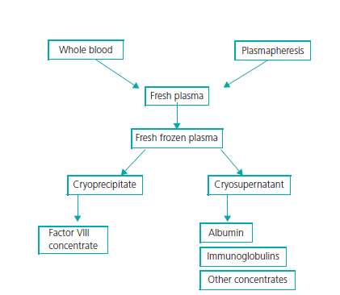
Blood products

Slide 19
Blood transfusion-indications
Haemorrhagic anaemia-trauma/surgical
Booster during cytotoxic therapy
Thrombocytopenia
Haemostasis-platelets, plasma components

Slide 20
RBC transfusion
Only true indication is to augment tissue oxygen delivery-heart, brain, muscle
Thresholds-symptomatic, acute,immediate physical activity,heart,lung disease,not correctable other than transfusion
Triggers-Hb<7g/dl(healthy adults),8g/dl heart ds or frailer elderly ;<5g/dl high mortality

Slide 21
ADR of RBC transfusion
Alloimmunization-ABO incompatility,acute haemolytic rxn
K+ overload/toxicity
Ca++ chelation-coagulopathy
Non-haemolytic febrile rxns
Urticaria
Transmission of infections-HIV,bacterial, syphilis, mad cow dse

Slide 22
Platelet transfusions
Prophylactic or to treat thrombocytopenia
Bone marrow failure
Dose-10-15ml/Kg
Contraindicated in- HUS,TTP,HIT

Slide 23
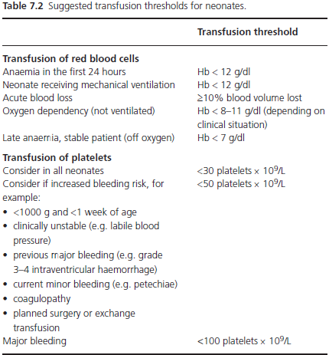

Slide 24
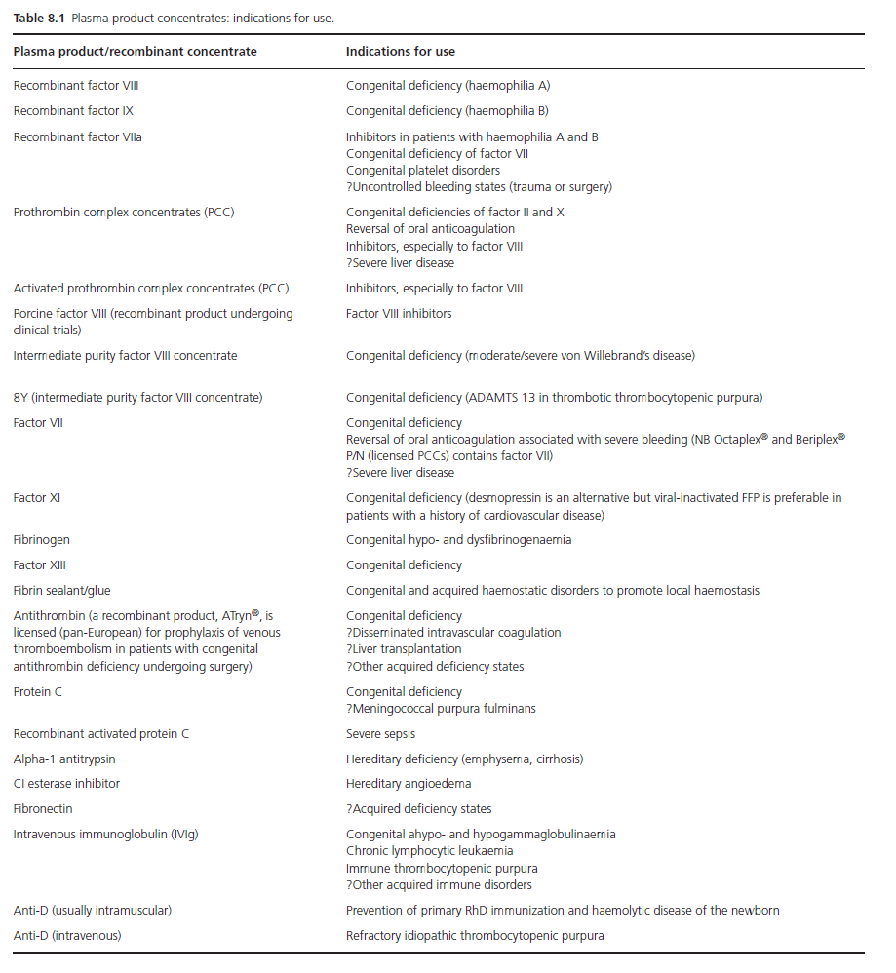

Slide 25
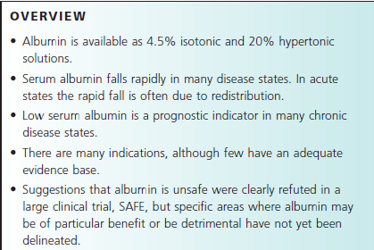
Human albumin

Slide 26
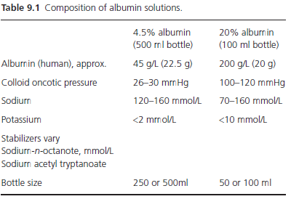

Slide 27
Treatment of Massive haemorrhage
Defn: requiring more than whole body blood volume transfusion
Severe shock-clinical,bld loss,
Pertinent issues-investigations, blood component transport, surgical haemostasis,source of bleeding,fluids,target BP,optimal Hb

Slide 28
Issues associated withmassive haemorrhage
Coagulopathy-dilutional,acidosis,hypothermia,thrombocytopenia
Electrolytes-hyperkalemia, hypocalcemia
Fibrinolysis
Recycling of autologous blood-cell salvage

