Slide 1
Evolving Paradigms in Trauma Induced Coagulopathy:
Crystalloid Haemodilution And Acidosis Revisited
Dr G Ogweno
Consultant Anaesthesiologist and Lecturer in Medical Physiology
Department of Medical Physiology
Kenyatta University
Nairobi, Kenya

Slide 2
Background
Worldwide, trauma continues to be leading cause of death in persons younger than 45 yrs
Haemorrhage accounts for 40% of all trauma deaths
Recalcitrant coagulopathy is observed in 30% of trauma cases within 24 hours of hospitalization
surgical control of bleeding extremely challenging in presence of established coagulopathy
Paradigms in mechanistic links in TIC/ACoTs are controversial, at best inadequate: Crystalloid Haemodilution and acidosis

Slide 3
Trauma, coagulopathy and mortality

Slide 4
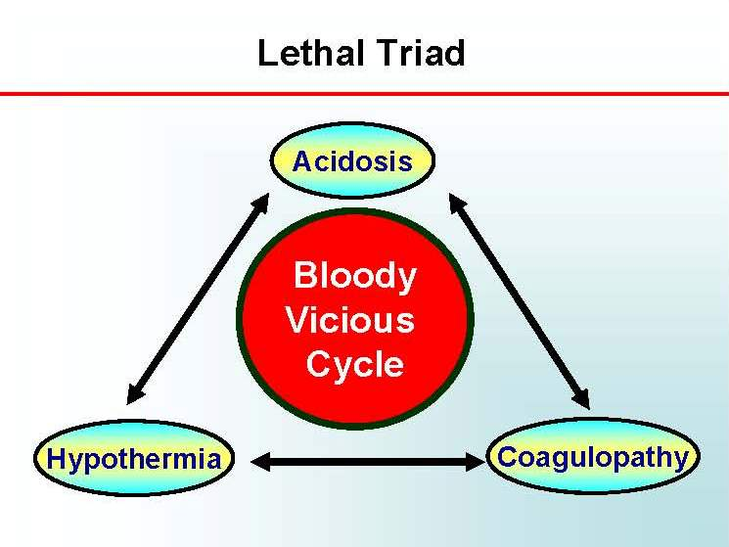
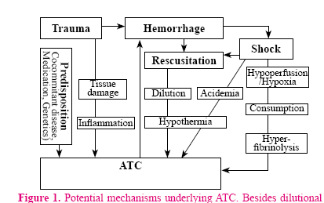
TIC Paradigm: Bloody viscous cycle

Slide 5
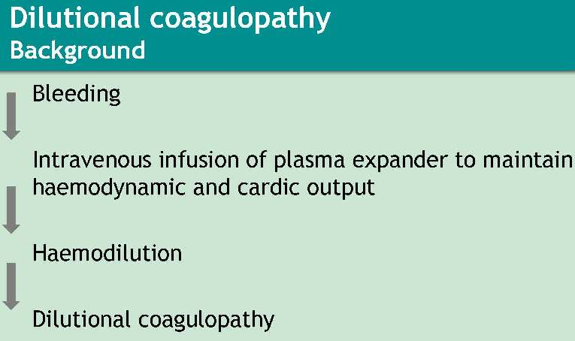

Slide 6
Crystalloids in TIC: Studies questioning role of Haemodilution
Simmons (Ann surg, 1969) coagulation disorders in Vietnam combat casualties-Despite PT and aPT not changed pre and post fluid resuscitation, oozing continued
it occurs early 40 minutes post injury (MacLeod, 2003),
before fluid administration (MacLeod, 2008; White, 2009; Brohi,2011)
independent of amount and type of fluids administered (Wafaisade, 2010) ),
Not critical in pathogenesis (Wohlauer,2012)

Slide 7
Isotonic saline in vivo
Javrin( 1980): crystalloid infusions associated with high incidence of DVT
Ruttmann (2002) Rapid crystalloid haemodilution enhanced perioperative coagulation on TEG ,related to dilution rather than surgery
Conclusion: saline is procoagulant,

Slide 8
Isotonic saline in vitro
Tocantins (1951): Accelerated clotting of hemophiliac blood on 0.85% saline upto 50% dilution
Monkhouse (1959): Antithrombin levels reduced after dilution
Heather (1980) Dilution of blood with 0.9% saline induced hypercoagulability on TEG assessement
Ruttmann (1996) confirmed finding of Heather
Ruttmann (1998) Colloids also enhanced coagulation on TEG but at lower dilutions
Ruttmann (2002): Hypercoagulability attenuated when antithrombin III kept at pre dilution levels
Conclusions: Crystalloid dilution enhances coagultion by reducing antithrombin III levels.Mechanism does not explain hypertonic solutions

Slide 9
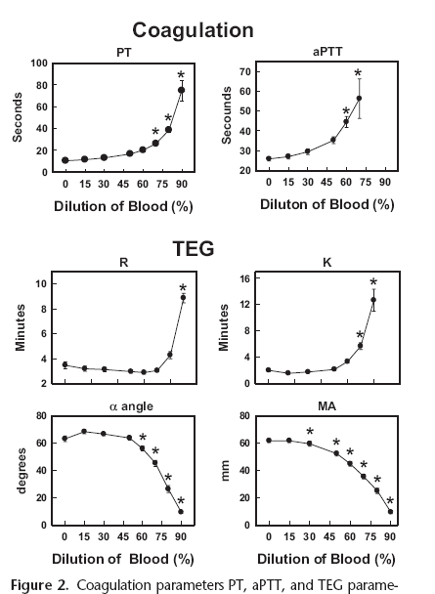
Effects of progressive crystalloid haemodilution

Slide 10
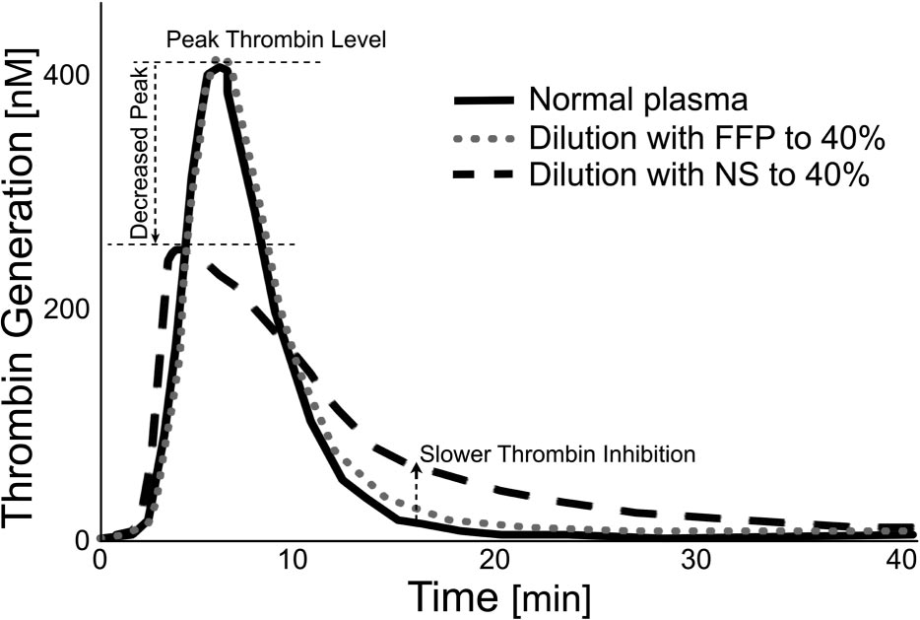
Crystalloid haemodilution on Thrombin generation
Anesthesiology 2010; 113:1016–8.

Slide 11
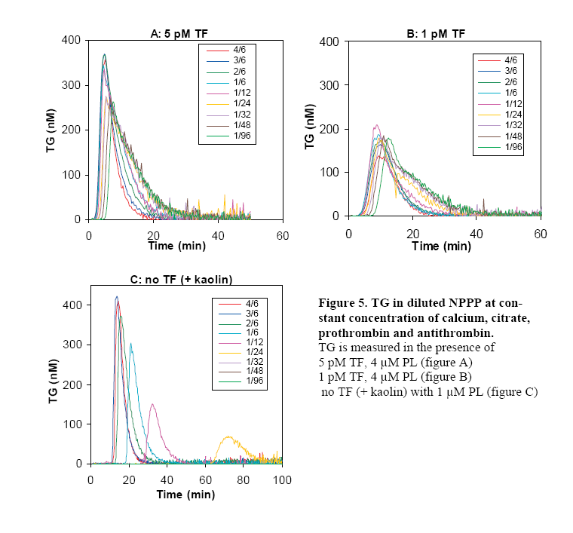
Plasma dilution:Dependence of Thrombin generation on trigger and its concentration
De Smedt, 2007(Thesis)(Throm Haemost,2009)

Slide 12
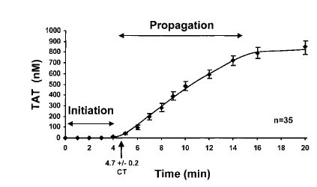
Initiation of clot formation requires 5% of Thrombin

Slide 13
Literature support for acidosis in coagulopathy: in vitro studies
Engstrom (J Trauma. 2006;61:624–628.) HCL acidosis impairs coagulation-TEG study in vitro
Darlington(Int J Burn Trauma 2012;2(3) ;J Trauma. 2011;)-HCL
Martini (Crit Care Med 2007; 35:1568–1574)
Engstrom (J Neurosurg Anesthesiol 2006)-Lactic acid : TEG study in vitro
Lier (J Trauma. 2008) in vivo

Slide 14
Correlation of acidosis and coagulopathy
Cannon (1918)
Niles (J Trauma, 2008)-acidosis and coagulopathy increases mortality
MacLeod (J Trauma, 2003)-Acidosis and ATC on mortality
Cosgriff (J Trauma, 1997)-acidosis and life threatening coagulopathy in MT
Davis( J Trauma, 1996)-admission BD and transfusion requirements

Slide 15
Pathogenesis of TIC: Role of acidosis discounted
Cannon (1918)-coagulopathy in association with acidosis not correctable by bicarbonate
Simmons (1969) Hypercoagulable values found even in shock, acidosis and lactaemia-relation between acidosis and coagulopathy invariable
Infusion of sodabic induced coagulopathy (
Coagulopathy poorly correlated to Base excess (MacLeod, 2011)
and not normalized by alkali correction of acidosis (ref).

Slide 16
Other factors associated with TIC
Activation of fibrinolytic system
Activation of natural anticoagulants: Protein C, TFPI, thrombomodulin
Consumption/degradation of fibrin(gen)
Impaired fibrin polymerization
Platelet dysregulation

Slide 17
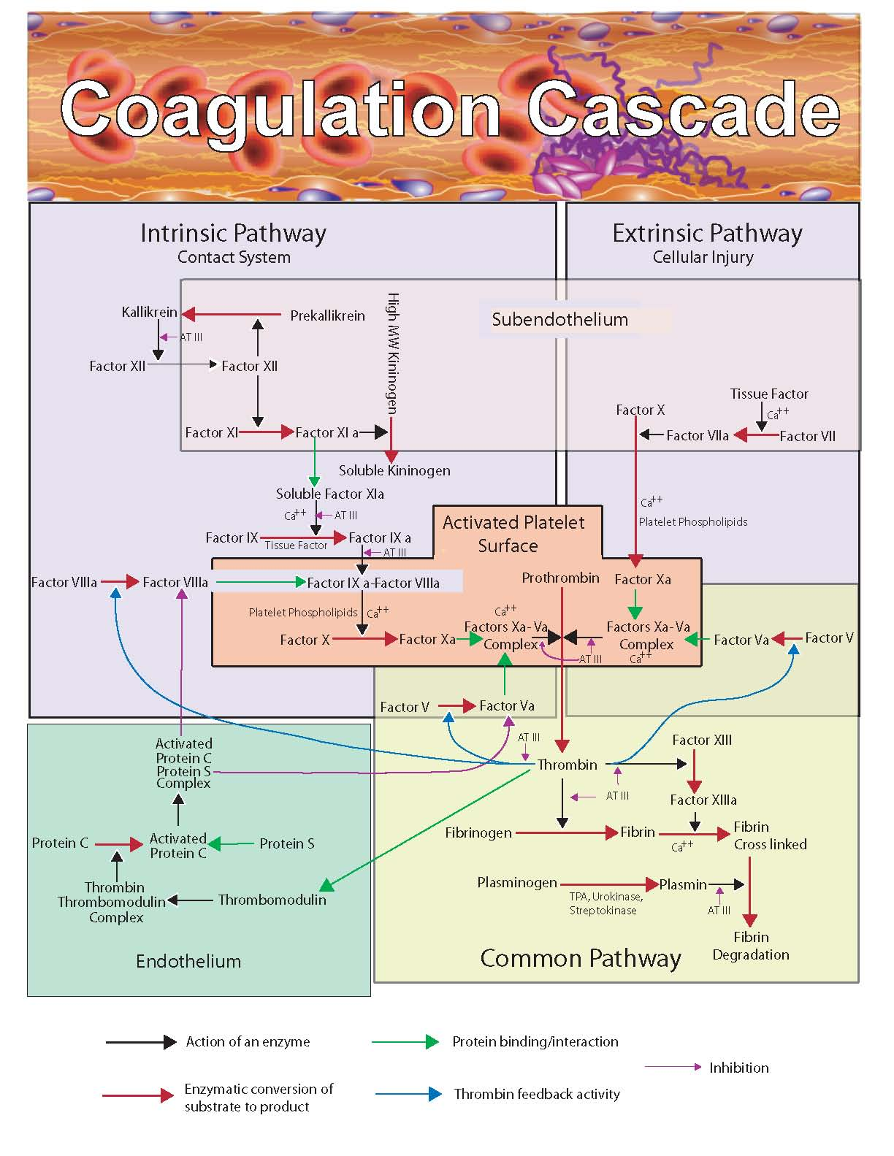
Modified coagulation cascade

Slide 18
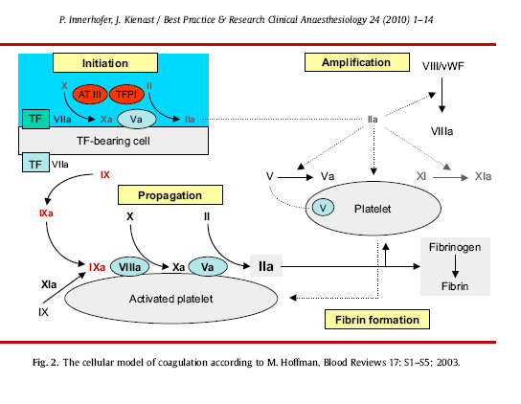
Cell based coagulation model

Slide 19
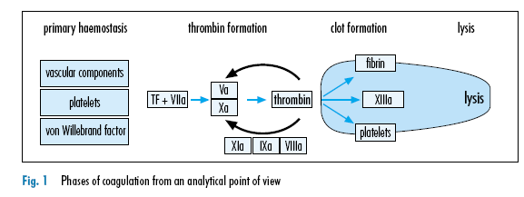

Slide 20
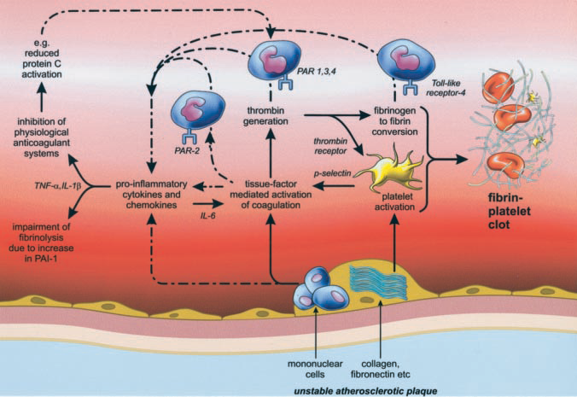
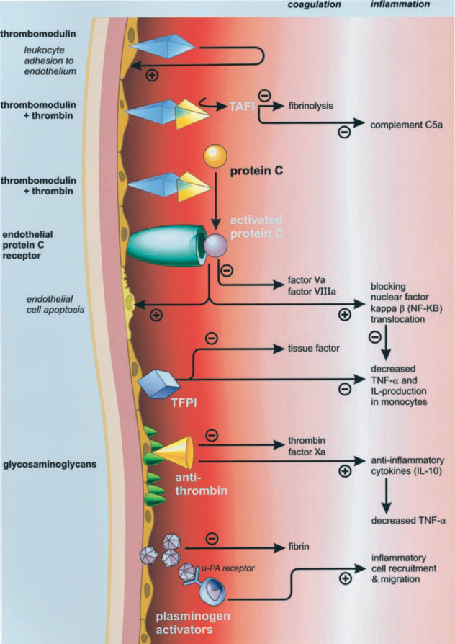
Interaction of factors

Slide 21
Summary
Paradigm of ‘bloody viscous cycle’ focusing on haemodilution, acidosis and hypothermia has evolved
Recent evidence - coagulopathy occurs early post injury
Most likely part of inflammatory process activating fibrinolysis and natural anticoagulants
Occurs independent of consequence of tissue injury (acidosis) and interventions ( crystalloid infusion
Cannons observations not fully explained by current paradigms

