Slide 1


Ethical Review Requirements in Research Involving Humans (BIOETHICS)
Prof. Nicholas K. Gikonyo
Chairman: KU Ethics Review Committee
chairman.kuerc@ku.ac.ke
ercku2008@gmail.com
www.ku.ac.ke
Dept of Pharmacy and Complementary /Alternative Medicine
nkgikonyo@gmail.com, ngikonyo@ku.ac.ke

Slide 2
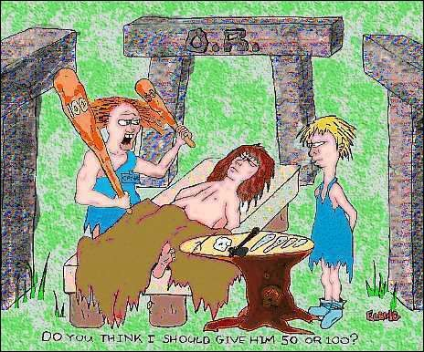
In antiquity ……

Slide 3
AT THE END OF THE PRESENTATION
DEFINE BIOETHICS
STATE THE ORIGINS OF RESEARCH ETHICS
QUOTE SOME PROBLEMS OF RESEARCH ETHICS
STATE WHY ETHICS IS IMPORTANT
STATE ETHICAL PRINCIPLES OF RESEARCH WITH HUMANS
APPRECIATE THE PROPOSAL AS THE BASIS OF ETHICS
KENYATTA UNIVERSITY ETHICS REVIEW COMMITTEE
KNOW THE PROCESS OF SUBMITTING A PROPOSAL TO KUERC
EXPLAIN THE ELEMENTS OF REVIEW
DEFINE THE VULNERABLE GROUPS

Slide 4
WHAT IS BIOETHICS?
“The systematic study of the moral dimensions in life sciences and healthcare including
moral vision,
decisions,
conduct and policies ,
  employing a variety of ethical methodologies in an inter-disciplinary setting”
(Daniel Collahan In “Bioethics as a Discipline” in the Hastings Center Studies, 1973)

Slide 5
EARLY DEBATES ON BIOETHICS
“The debate on moral virtues and obligations and ethical dilemmas and choices in healthcare e.g.
          abortion,
          mutilation of the body,
          life prolonging treatment,
          cloning,
          consent
          etc;
have disturbed physicians, theologians, philosophers ,etc. for many years.

Slide 6
EVOLUTION OF BIOETHICS
Contemporary discipline of bioethics began to emerge in 1960’s involving more actors such as natural scientists, legal scholars, behavioural scientists, policy makers, etc in addition to health professionals

Slide 7
WHAT IS BIOMEDICAL RESEARCH?
Includes:
Clinical, Pharmaceuticals, Medical devices, Medical radiation and imaging, Surgical procedures, Biological samples,
Medical records,, Epidemiological, Social, Psychological and Behavioural investigations.

Slide 8
ORIGINS OF HUMAN SUBJECT
RESEARCH ETHICS
WILLIAM BEAUMONT (1833)
Oldest American document dealing with research ethics
  Experimentation is needed
  Investigator must be responsible;
  Voluntary consent is necessary
  Discontinuation of experiment when it causes distress to the subject or the participant objects or becomes dissatisfied.

Slide 9
PROBLEMS WITH HUMAN
SUBJECT EXPERIMENTATION:
1. 1900 - Dr. Neisser studied immunization of healthy persons
  against syphilis by
      inoculating them with serum from syphilitic patients.
  3 prostitutes inoculated; all contracted syphilis.
  No consent obtained.
2. Reich Health Council:
Tuberculosis vaccination, 75 children died during experiments
Puerto Rico:
Contraceptive research on POOR WOMEN without their knowledge or consent

Slide 10
PROBLEMS WITH HUMAN SUBJECT EXPERIMENTATION:
Tuskegee Study 1932 – 1972: Alabama USA
Study on the effects of untreated syphilis (Natural History of Syphilis )
Studied the effects of spontaneous evolution of syphilis on black males
Participants – Black men
Penicillin available in 1940’s
Not available to participants
What happened?
    •28 deaths
    •100 cases of disability

Slide 11
Tuskegee Study
Study participants poor and illiterate;
most had never seen a doctor before
Participants were rewarded with
Free physical examination
Free transport to the clinic
Hot meals on examination days
Free treatment for minor ailments
Given a BURIAL STIPEND
  “Nurse Rivers” – tracked participants/patients
Press later labeled it “racial medicine”.
President Clinton’s Public apology for tragedy 16.5.1997

Slide 12
PROBLEMS WITH HUMAN SUBJECT EXPERIMENTATION:
5. Nazi Germany
Dr. Mengele’s Experiments
  Infected one twin with a “germ”. When s/he died, the other twin was killed and their organs compared at autopsy.
  Sewed twins together to create a Siamese twin.
  Studied persons with genetic traits so as to
  better “purify the Aryan super race”.
  Performed cross transfusions to “make boys into girls and girls into boys”.

Slide 13
POST WAR RESPONSE
“The Case Against the Nazi Physicians”
Nuremberg Doctors’ Trial – 1946 –47
  23 defendants; 3 non-physicians
    16 found guilty
    7 were hanged
    5 sentenced to life in prison
    4 sentenced to 10-20 years in prison
    7 were acquitted and freed.

Slide 14
WHY IS ETHICS
IMPORTANT IN RESEARCH?
Human participants in research may be harmed
Protections and safeguards are needed to prevent harms
Not all risks can be predicted in advance
Harms may outweigh benefits
To treat people as a “mere means” or
  “objects” to benefit others is wrong
Individuals have human rights

Slide 15
ETHICAL PRINCIPLES OF RESEARCH
WITH HUMANS
The principle of respect
Principle of beneficence
Justice and equitability

Slide 16
RESPECT
Respect for persons
      Obtain informed consent
      Participants free to withdraw
      Privacy to be respected
      Confidentiality must be protected

Slide 17
BENEFICENCE
Maximize expected benefits and minimize potential harms
Ensure that research design is adequate to derive benefits from results

Slide 18
DISTRIBUTIVE JUSTICE
Benefits and burdens of research should be distributed fairly among all social and economic classes and ethnic and racial groups in society

Slide 19
UNESCO DECLARATION
Community consent-article 6
Vulnerability-article 8 (prisoners, underdeveloped, married women in rural areas, pregnant and lactating,children, foetuses)
Cultural diversity and pluralism-article 9
Social responsibility-article 14(national relevance)
Benefit sharing-article 15(availabilibility, affordability,accessibility)
Transnational practices-article 21(illicit trafficking of organs, tissues, sera,genetic material)
Bioethics education, training and information-article 23

Slide 20
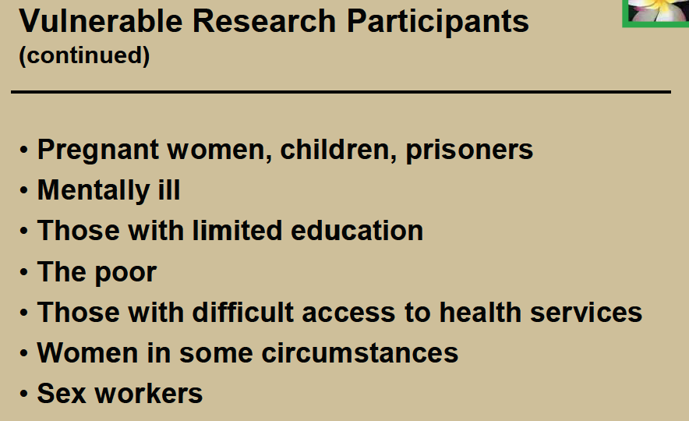

Slide 21
Ethics in Research
Components of a Research Proposal
www.ku.ac.ke

Slide 22
Roles of local ERC/IRB
Ensures that the research:
Design and objectives are scientifically sound
Question is relevant to the local environment
Respectful of local cultures and practices
Compliance with legislations and statutes
Data monitoring and evaluation
Conduct, training and competence of personnell
Review of human volunteers, human tissues, identifiable human data

Slide 23
Roles of Statutory bodies
Inspection of research sites and audit of research conduct
Safety monitoring
Ordering for termination or investigation of misconduct
Receiving complaints about misconduct
Recommending criminal prosecution
Periodic surveillance of adherence/ misconduct

Slide 24
Purpose of the proposal
First and most important stage of documenting any research study
Blue print for intended research
Funding requirements
University degree- dissertation/thesis
Academic research

Slide 25
Components of a Research Proposal
Title page
Summary/abstract
Introduction and Literature review
Justification of the research problem
Hypothesis/study questions
Objectives
Research methodology (Ethical issues)
Data analysis

Slide 26
Research methodology
Study design
  Epidemiology studies
  Descriptive study
  Cohort study
  Randomized clinical trial
  Case: Control study
  Interventional studies

Slide 27
Study area and population
Describe in details where the study will be
conducted
  Study area (s)
Study population
Inclusion and exclusion criteria
Sample size calculation according to the study design

Slide 28
Data collection
Recruitment procedures and consenting
Sampling techniques
  Randomization process
  Consecutive
  others

Slide 29
Data collection cont.
Procedures
Study instrument
    Clinical procedures
    Laboratory- techniques
    Questionnaires
Trained research assistants

Slide 30
Ethical consideration
Who will give the ethical approval?
Who will give the research permit?
Written consent
Participant information sheet
Consent form
Risks and benefits
Incentives
Signatures
Information on who to contact

Slide 31
Time line/Work plan
Lists the major activities and stated time:
Activity | Time (years quarters)
 | QRT1 | QRT2 | QRT3 | QRT4
Proposal writing
Ethical clearance
Recruitment of workers
Pretesting and training
Data collection
Data entry
Data analysis
Report writing

Slide 32
Budget
Should be realistic
Justified
Costing should be verified
Arrange budget under major categories
Include contingency
Include institutional support
Include ethical clearance fee

Slide 33
Appendices
Curriculum vitae
Study instruments/questionnaires
Information sheet and consent form
Brochures to be distributed
Special procedures
Quality assurance procedures
Others

Slide 34
THE ROLE OF KU-Ethics Review Committee
Review and clear proposed research before its commencement.
Provide INDEPENDENT, competent, and timely review of the ethics of proposed studies.
Review the adequacy of the informed consent document, particularly as to its description of the risks and benefits.

Slide 35
THE ROLE OF KU-ERC cont’d
Review prospective and continuing research protocols
Evaluate reports for unanticipated problems, possible non-compliance.
Act in the interest of potential research participants and concerned communities.

Slide 36
COMPLIANCE WITH THE KU-ERC OPERATIONAL GUIDELINES
Ensures that the dignity, rights, safety and well-being of research participants are promoted
The results of investigations are CREDIBLE.

Slide 37
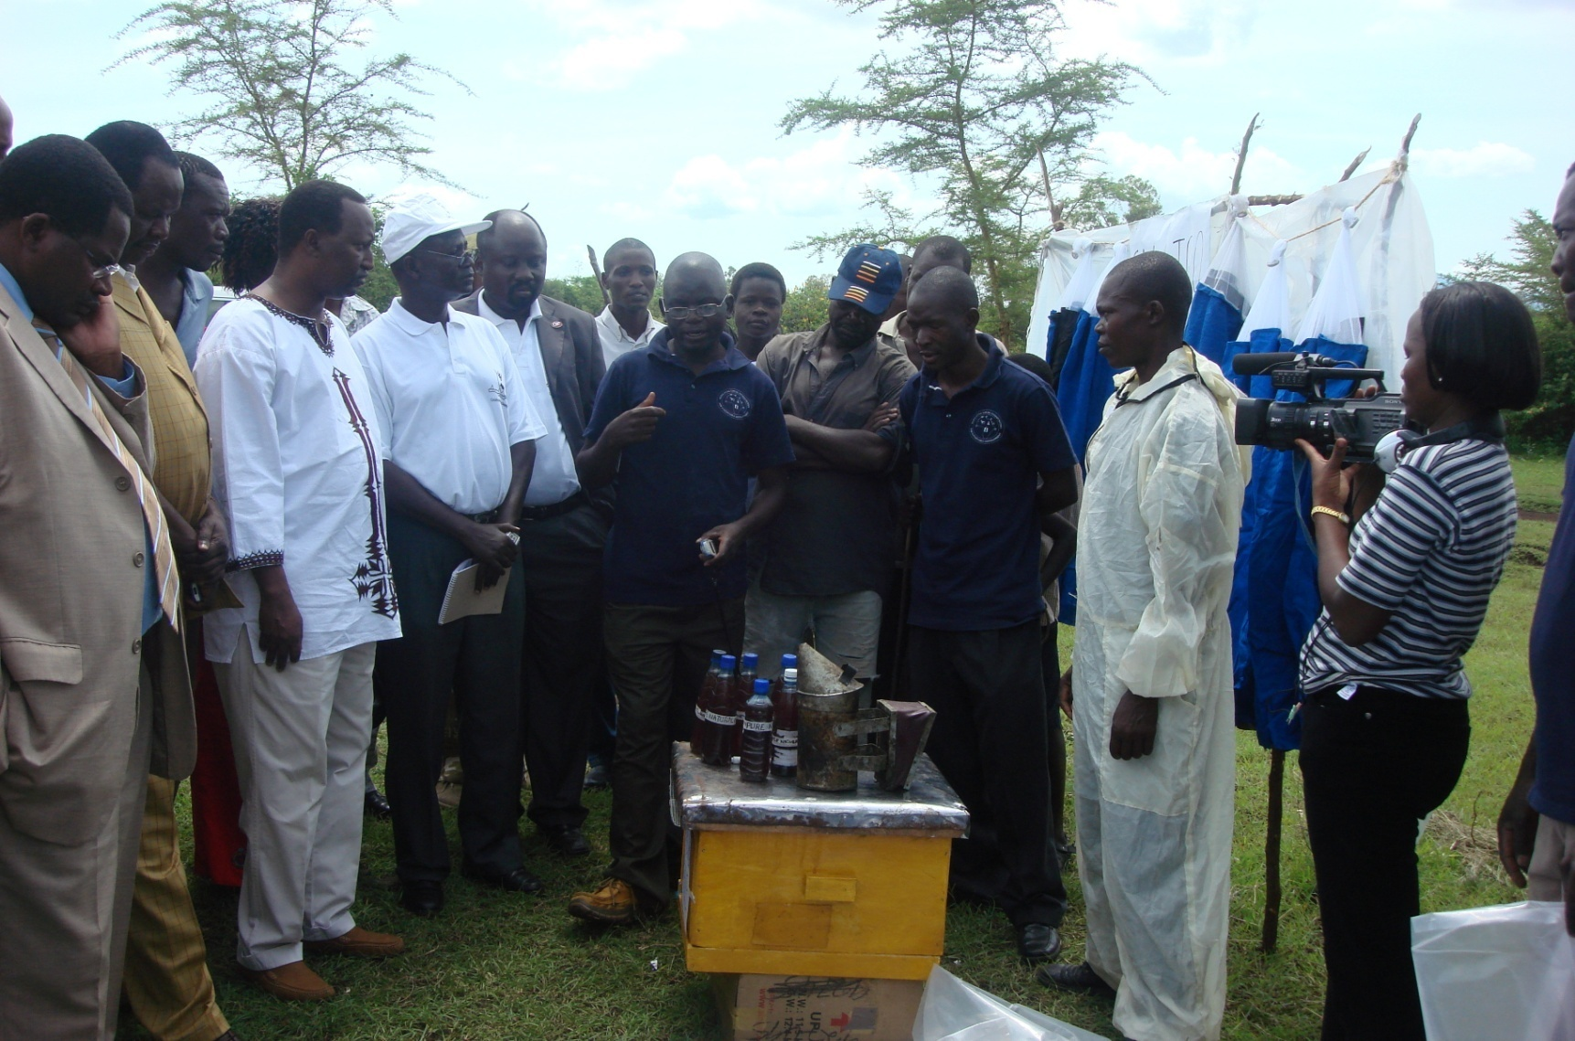
HOW IS CREDIBLE RESULTS DISSEMINATED?

Slide 38
Approval of proposed study by an
ERC is mandatory if you wish:
To publish research results in a credible journal,
To obtain a research permit from the National Commission for Science, Technology and Innovation (NACOSTI), formerly NCST

Slide 39
SUBMITTING AN APPLICATION
The KU-ERC secretariat receives research proposals for ethical review from applicants through the Institute of Research Science and Technology in the manner and format prescribed.
Application forms can be downloaded from the KU website www.ku.ac.ke

Slide 40
REVIEW
All properly submitted applications are reviewed in accordance with the procedure established by KU-ERC.
Academic proposals must be approved by Graduate School
The KUERC meets every 2nd Tuesday of a month.

Slide 41
ELEMENTS OF THE REVIEW
Scientific design and conduct of the study
Recruitment of research participants
Care and protection of research participants
Protection of research participants’ confidentiality
Informed consent process
Community considerations

Slide 42
Scientific design and conduct of the study
The appropriateness of the study design
The justification of predictable risks weighed against the anticipated benefits
The justification for the use of controls.
The adequacy of the site, including staff and facilities
The manner in which the results of the research will be disseminated.

Slide 43
Recruitment of research participants.
The characteristics of the research population
The means by which initial contact and recruitment is to be conducted.
Inclusion criteria for research participants.
Exclusion criteria for research participants.

Slide 44
Community considerations
Involvement of communities during designing the research.
Impact and relevance of the research on the local community.
Influence of the community on the consent of individuals.
Community consultation during the course of the research.
Contribution of research to capacity building.
Availability and affordability of study products to the community .
Availability of research results to research participants and communities.

Slide 45
Informed consent process
Description of the process for obtaining informed consent (especially for Vulnerable groups)
The adequacy, completeness, and understandability of written and oral information.
Justification to include individuals who cannot consent.
Assurance that research participants rights, safety, and well-being are safeguarded.
The provisions made for dealing with queries and complaints.

Slide 46
Who are Vulnerable?
Such groups are:
  Children,
  Malnourished people,
  Pregnant women,
  Elderly people,
  Immune-compromised people,
  People who have undergone adverse emotional
  /traumatic events,
  Drug addicts,
  Homeless people

Slide 47
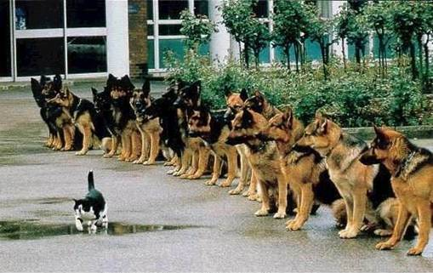
ERC

Slide 48
SUMMARY
TRANSFORMATIONAL RESEARCH
WHAT IS BIOETHICS
ORIGINS OF RESEARCH ETHICS
PROBLEMS OF RESEARCH ETHICS
WHY ETHICS IS IMPORTANT
ETHICAL PRINCIPLES OF RESEARCH WITH HUMANS
PROPOSAL AS THE BASIS OF ETHICS
KENYATTA UNIVERSITY ETHICS REVIEW COMMITTEE
SUBMITTING A PROPOSAL TO KUERC
ELEMENTS OF REVIEW
VULNERABLE GROUPS

Slide 49
Thanks

