Slide 1
THE AFRICAN CENTRE FOR TRANSFORMATIVE AND INCLUSIVE LEADERSHIP
AGRIFOOD EFFICIENCY MARKETING SYSTEM:
A CASE STUDY ON MACADAMIA NUTS VALUE CHAIN IN FIVE SELECTED COUNTIES OF CENTRAL KENYA HIGHLANDS
African highland Nuts,
P.O BOX 75844-00200
Nairobi Kenya.
E-MAIL: meleeneastafrica@yahoo.com
A presentation paper on Agribusiness case study on macadamia nuts at Kenyatta University Transformative Leadership and Agribusiness Training
On 31st July, 2013
By Wilfred M. Murioga
An entrepreneur, PhD Student and a former business mentor/business consultant Kenyatta University.

Slide 2
INTRODUCTION
Macadamia was introduced in Kenya in 1946 by Bob Harries on trial basis, and planting as complimentary cash crop to coffee began in central, Eastern and Coast provinces, (National Nut crops developments policy, 2007).
Commercial farming was introduced in late sixties by ministry of Agriculture with no research done to find suitable varieties or proper market channels. Macadamia is currently treated as one of the scheduled crops.
Farmers were encouraged to plant macadamia in believe that the income from macadamia will be comparable or better than coffee and Tea which were main cash crops, and yet there was no single processor in Kenya until when Kenya Nuts company was registered in 1974 and started operations in 1977.

Slide 3
THE BACKGROUND OF MELEEN (E.A)
The functions of organization are:
To buy Macadamia nuts from farmers in five Counties of Central Kenya Highlands.
To process to various products which include Kernel, edible and cosmetic oils, and also make other by-products.
Market all the products to local market; both local and international market.

Slide 4
A BRIEF HISTORY OF MELEEN (E.A)
The company was founded in 2003 and is a family business employing about 20 people.
Challenges
Lack of quality raw materials.
Technology.
Stiff Competition.
High cost of Infrastructure
Market
Political instability (2002 and 2007)

Slide 5
STATEMENT OF THE PROBLEM
The macadamia industry in Kenya is a complex one with many diverse interested players, all fighting for the control of Macadamia market, which is assumed to be very profitable against a background of few drying factories and processing plants being closed in the last few years.
This study investigated the risks and costs involved in transactions while trading on macadamia nuts in the various stages within the long chain and analyzed the market system. In the study we investigated how quality of nuts affect processors ability to enter into contract in the international market, which also affects the small-scale farmers decreasing market share.

Slide 6
RESEARCH OBJECTIVES
Broadly, this study sought to investigate and study multi- factors and main players that affect the value chain efficiency of Macadamia marketing system in Kenya, with a specific focus on five selected counties in the central Kenya highlands.
The specific objectives were to:
Investigate infrastructure and organisational barriers of efficient macadamia market systems.
Examine the flow of information between pairs of market centres and between pairs of traders.
Determine the level of quality control standards.
Analyse price policies and the speed of price transmission of macadamia prices between various market centres in the selected counties.
Investigate the level of market concentration and integration between pairs of traders and market centres
Determine the level of promotions, and advertising employed in the macadamia trade.
Analyse the percentage of margins earned by traders and roles they play to earn the margins and whether they are excessive

Slide 7
Table 1.1 A summary of Macadamia Nuts Production (2000-2011)
Year | Area HA | Prod. MT | Value KSH | KSH | Value KG KSH
2002 | 854 | 4,359 | 95,830,000 | 21,984 | 21.98
2003 | 2213 | 10,179 | 124,993,000 | 12,279 | 12.28
2004 | 2150 | 11,941 | 493,595,000 | 41,336 | 41.34
2005 | 2591 | 18,137 | 1,088,220,000 | 60,000 | 60.00
2006 | 2935 | 20,545 | 1,222,850,000 | 59,518 | 59.52
2007 | 2801 | 19,607 | 962,080,000 | 49,068 | 49.10
2008 | 3382 | 19,290 | 547,330,000 | 28,374 | 28.37
2009 | 2183 | 16,769 | 421,907,000 | 25,153 | 25.15
2010 | 3950 | 19,229 | 1,250,000,000 | 65,000 | 65.00
2011 | 5,640 | 26,634 | 2,277,000,000 | 85,000 | 85.00
TOTAL | 28699 | 166690 | 6434505000 | 3860162 | 447.74
MEAN RATE | 2870 | 1666.90 | 64345050 | 3860 | 44.77
Source: Kenya nation bearau of Statistic( KNBS), (2011) and HCDA 2012 report.
Area= hectare; Production = Metric tonnes; = Kenya shillings

Slide 8
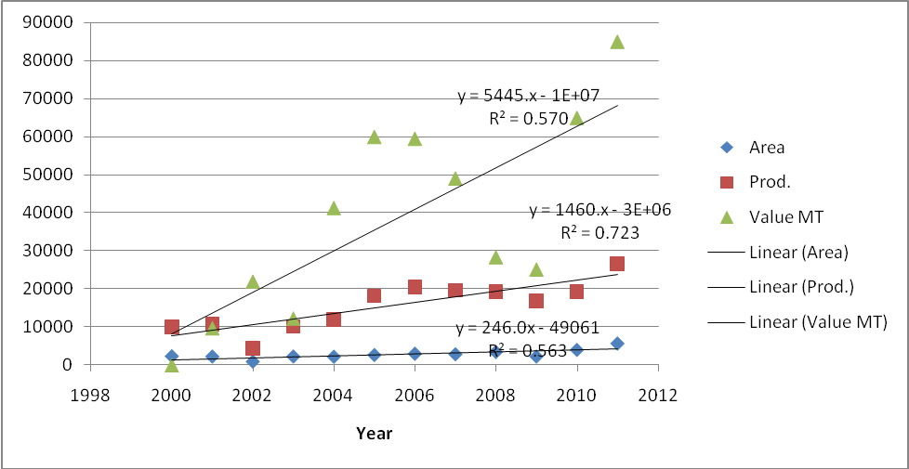
Figure 1.1: The Summary of Macadamia nuts Production (2000-2011)
Source: Author, 2012

Slide 9
Table 1.2: Ages of respondents across designation
Age of the respondents | Farmers |  | Middlemen |  | Processors |  | Retailer |  | Consumer
 | F | % | F | % | F | % | F | % | F | %
Below 20 year | 4 | 2.5 | - | - | - | - | - | - | 8 | 12.3
21-29 | 16 | 9.9 | 9 | 32.1 | 1 | 14.3 | 21 | 70.0 | 26 | 40.0
30 – 39 | 44 | 27.2 | 12 | 42.9 | 5 | 71.4 | 7 | 23.3 | 14 | 21.5
40 – 49 | 40 | 24.7 | 5 | 17.9 | 1 | 14.3 | 2 | 6.7 | 11 | 16.9
Over 50 years | 58 | 35.8 | 2 | 7.1 | - | - | - | - | 6 | 9.2
Total (N) | 162 | 100 | 28 | 100 | 7 | 100 | 30 | 100 | 65 | 100

Slide 10
6.2 Conclusion
The study was carried in central Kenya highlands in selected five counties which produces over 60% of all macadamia produced in Kenya as indicated by HCDA (2011) validated report. A total of 12 counties in Kenya produces macadamia but it was not economically possible to carry research in all these producing counties due to financial and time constraint. The study found out that market activities such as flow of information, market barriers, price policies, promotion and advertisement have a close relationship and a direct impact on the efficiency of macadamia marketing system in central Kenya highlands.
From the study findings, it can be concluded that the seven market activities and the five level players in the macadamia marketing system which were assessed, investigated and analysed as a whole affect positively or negatively in one way or another the efficiency of macadamia marketing in the central Kenya highlands. The flow of information, for example, has a ripple effect on the macadamia marketing system. The failure of the feed forward information to reach the intended players at the right time impacts directly to the supply of macadamia, its quality, demand, price, promotion strategy and the overall margins. The same applies to all other activities mentioned in the agrifood chain value efficiency marketing system.

Slide 11
6.3.0 Recommendations
Formation of auction Board
Improve Feed forward information system, procedures and requirements to improve communication in the industry
Develop Feedback information mechanism
Formulation of Government development policy on macadamia nuts
Grading and specification procedures to be set up and implement.

Slide 12
Summary
The study was on assessment and appraisal of Agrifood Chain efficiency marketing and Performance based on three dimensions:
Main marketing industry players who are in five levels.
Main market activities which include quality control, price policies, market margins, information flow, market concentration, market structures and infrastructures, and finally market promotions and advertisements.
Market organizations and government policies
The assessment is different from the convectional market efficiency appraisals in that we have used different dimensions instead on the normal either economic or cost efficiency.

Slide 13
FUTURE PLANS
Development of a new market policy and diversifying outside Kenya possibly Sudan.
Improving infrastructures by investing more capital by attracting investors.
Technology Improvement of technology by using reverse engineering which is cheaper.
Training of staff on new marketing methods
Entering into contract farming with farmers for better supply of raw material.
Training farmers on quality control systems by application of quality control circles to ensure that good quality raw materials are processed.
Sudan consulting officer
Ammar ibrahim mohamed stepamma@gmail.com +249-122390148
TARIGELBREIR elnein71@gmail.com +249911353859

